Slide 1
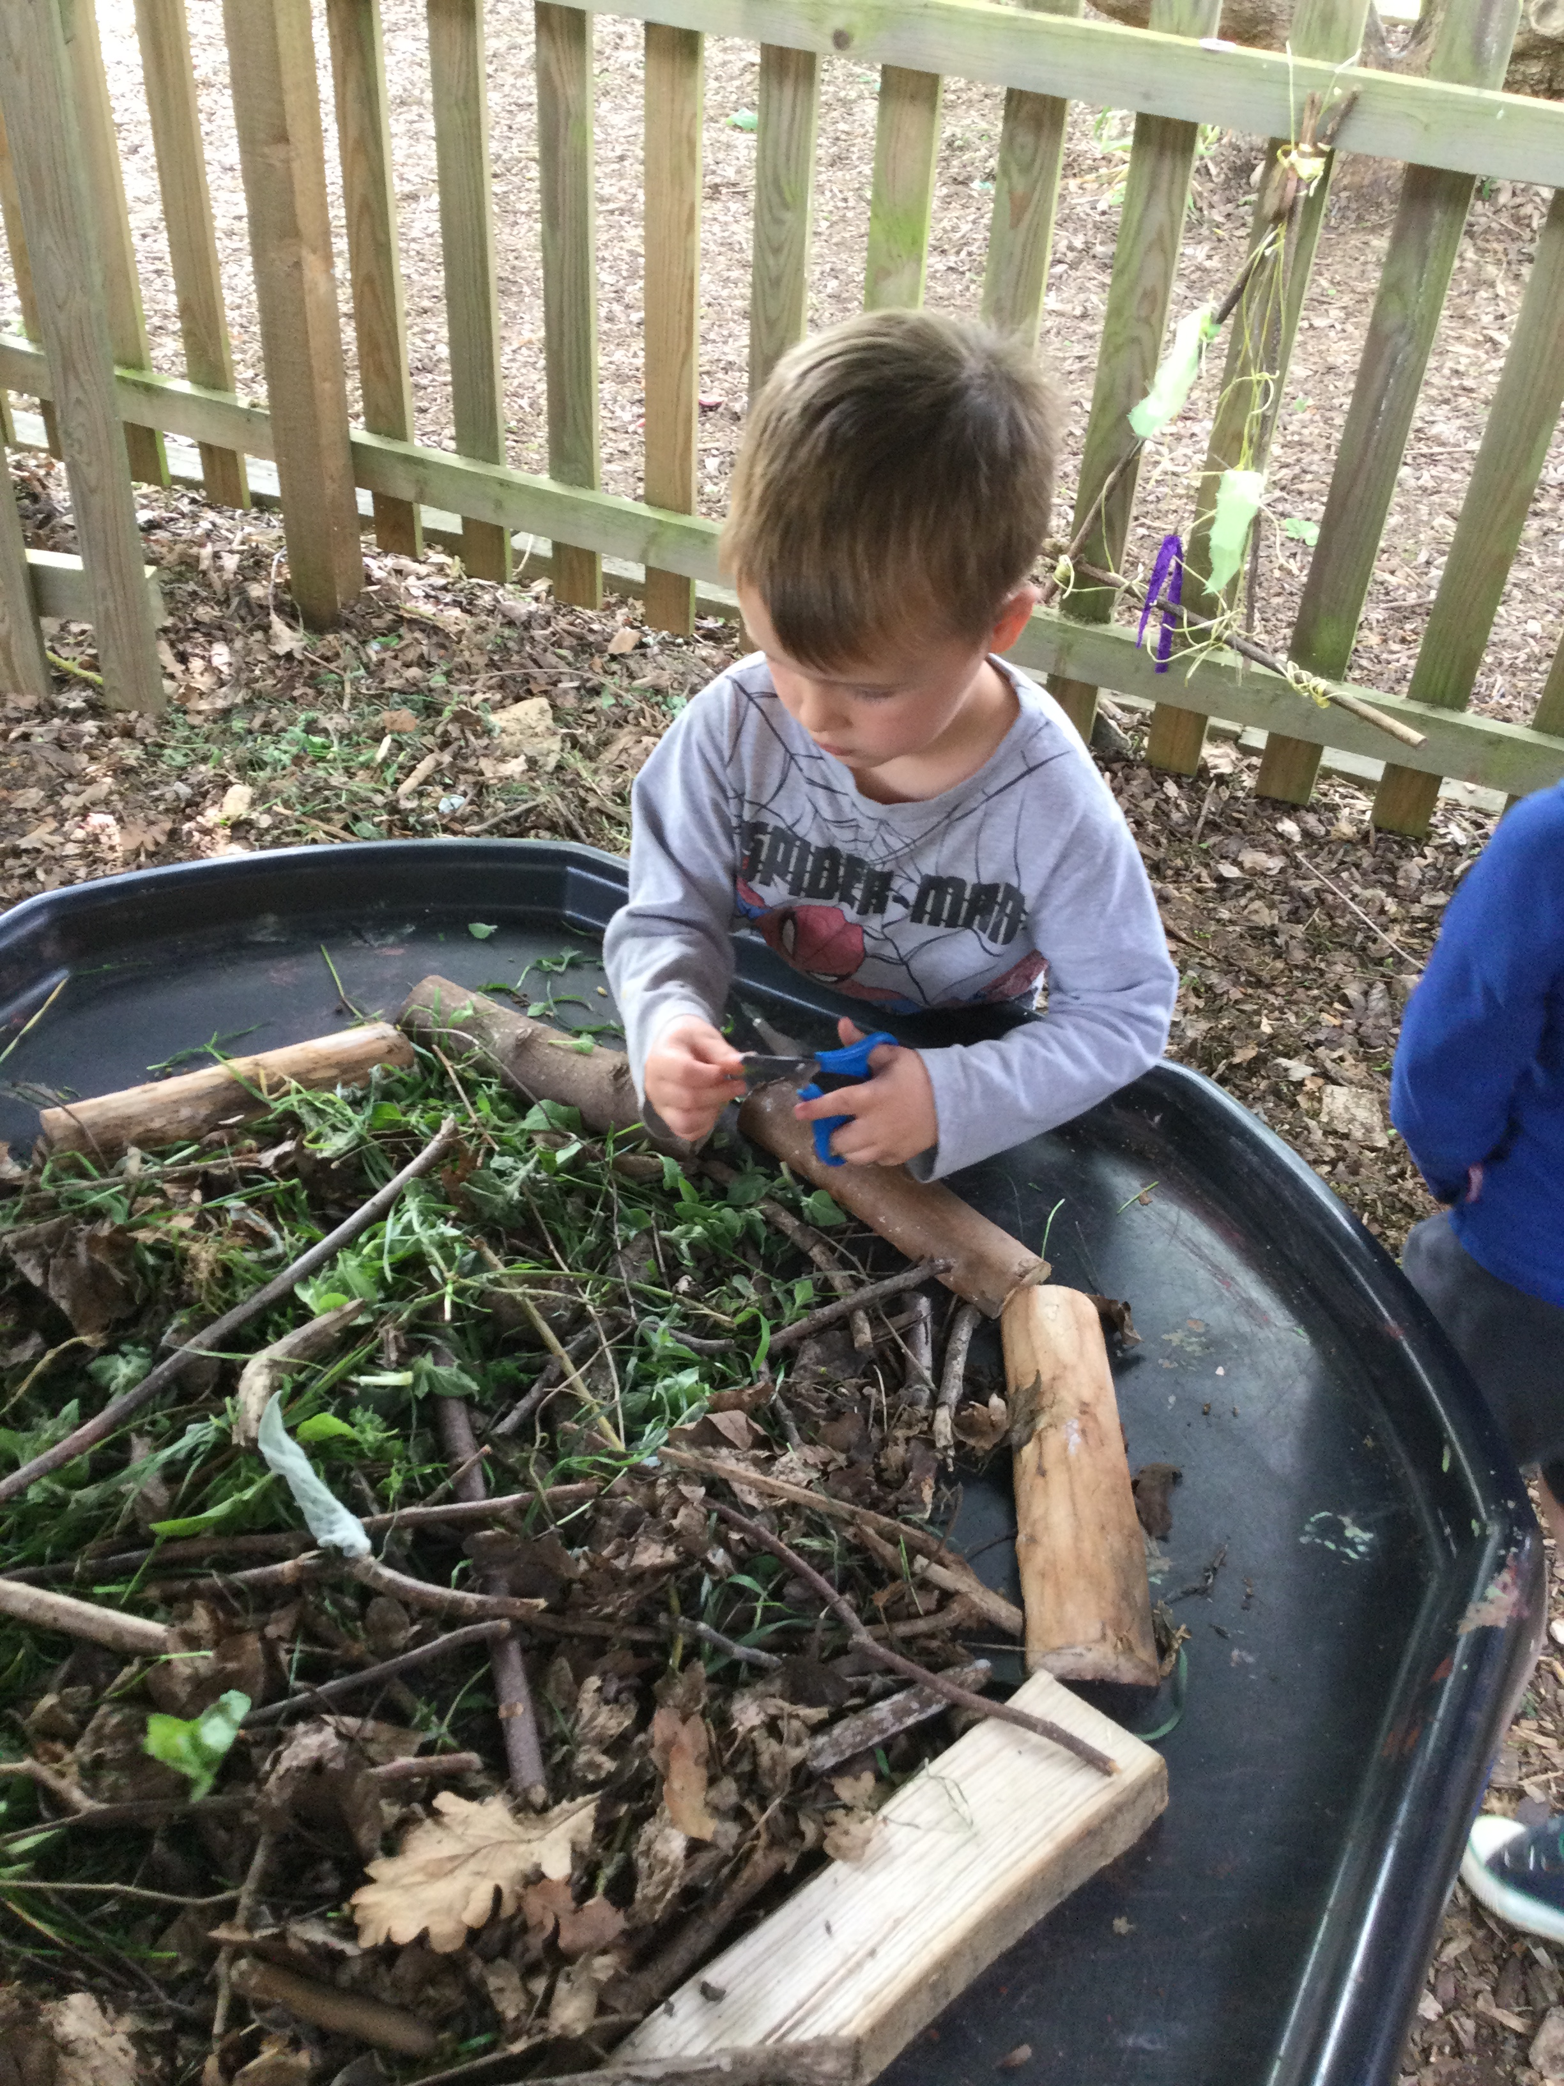
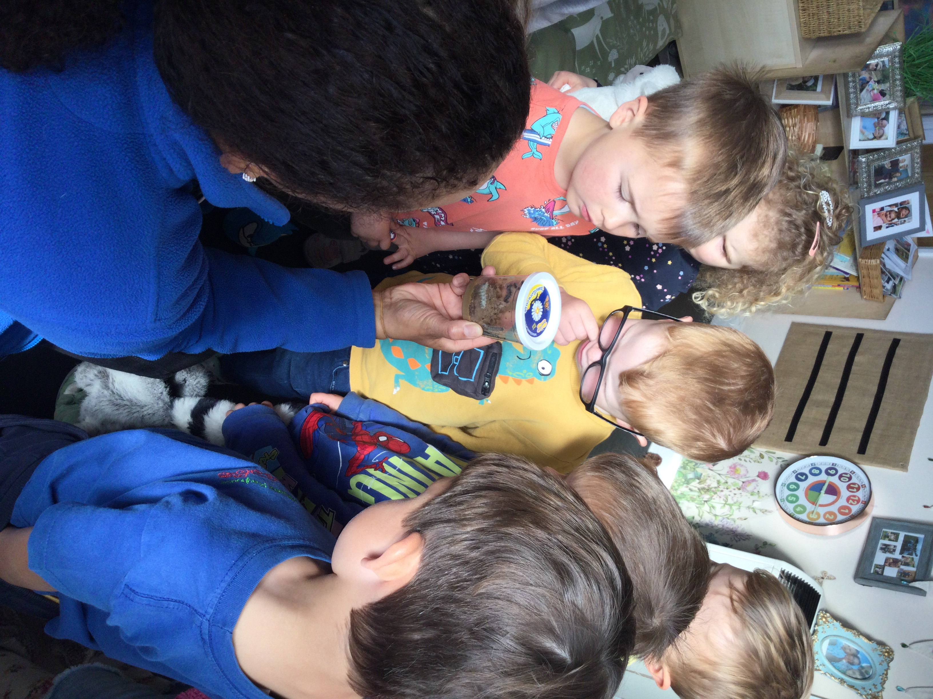
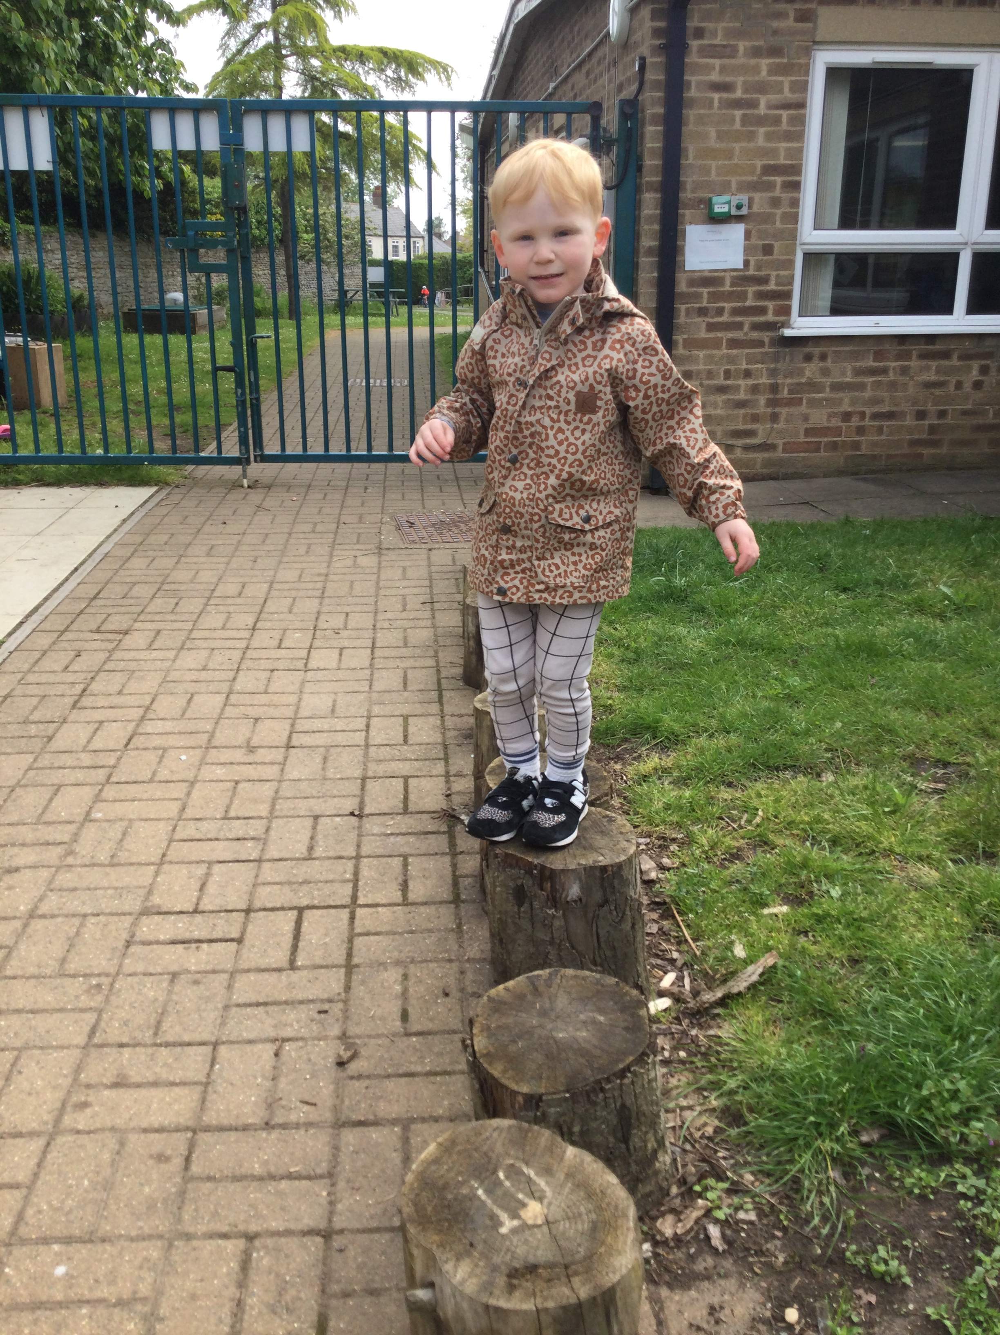
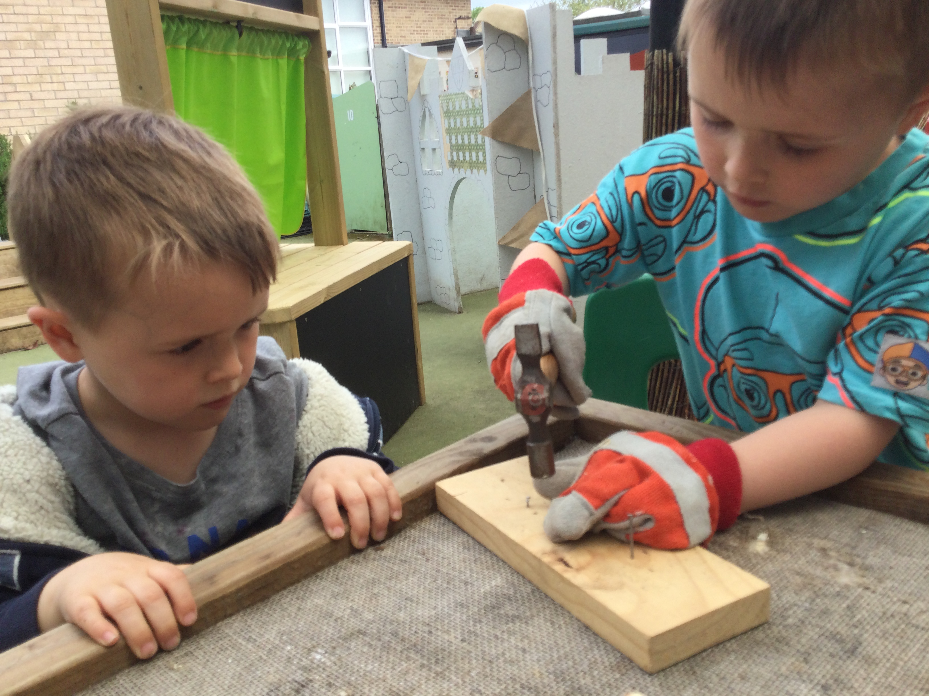
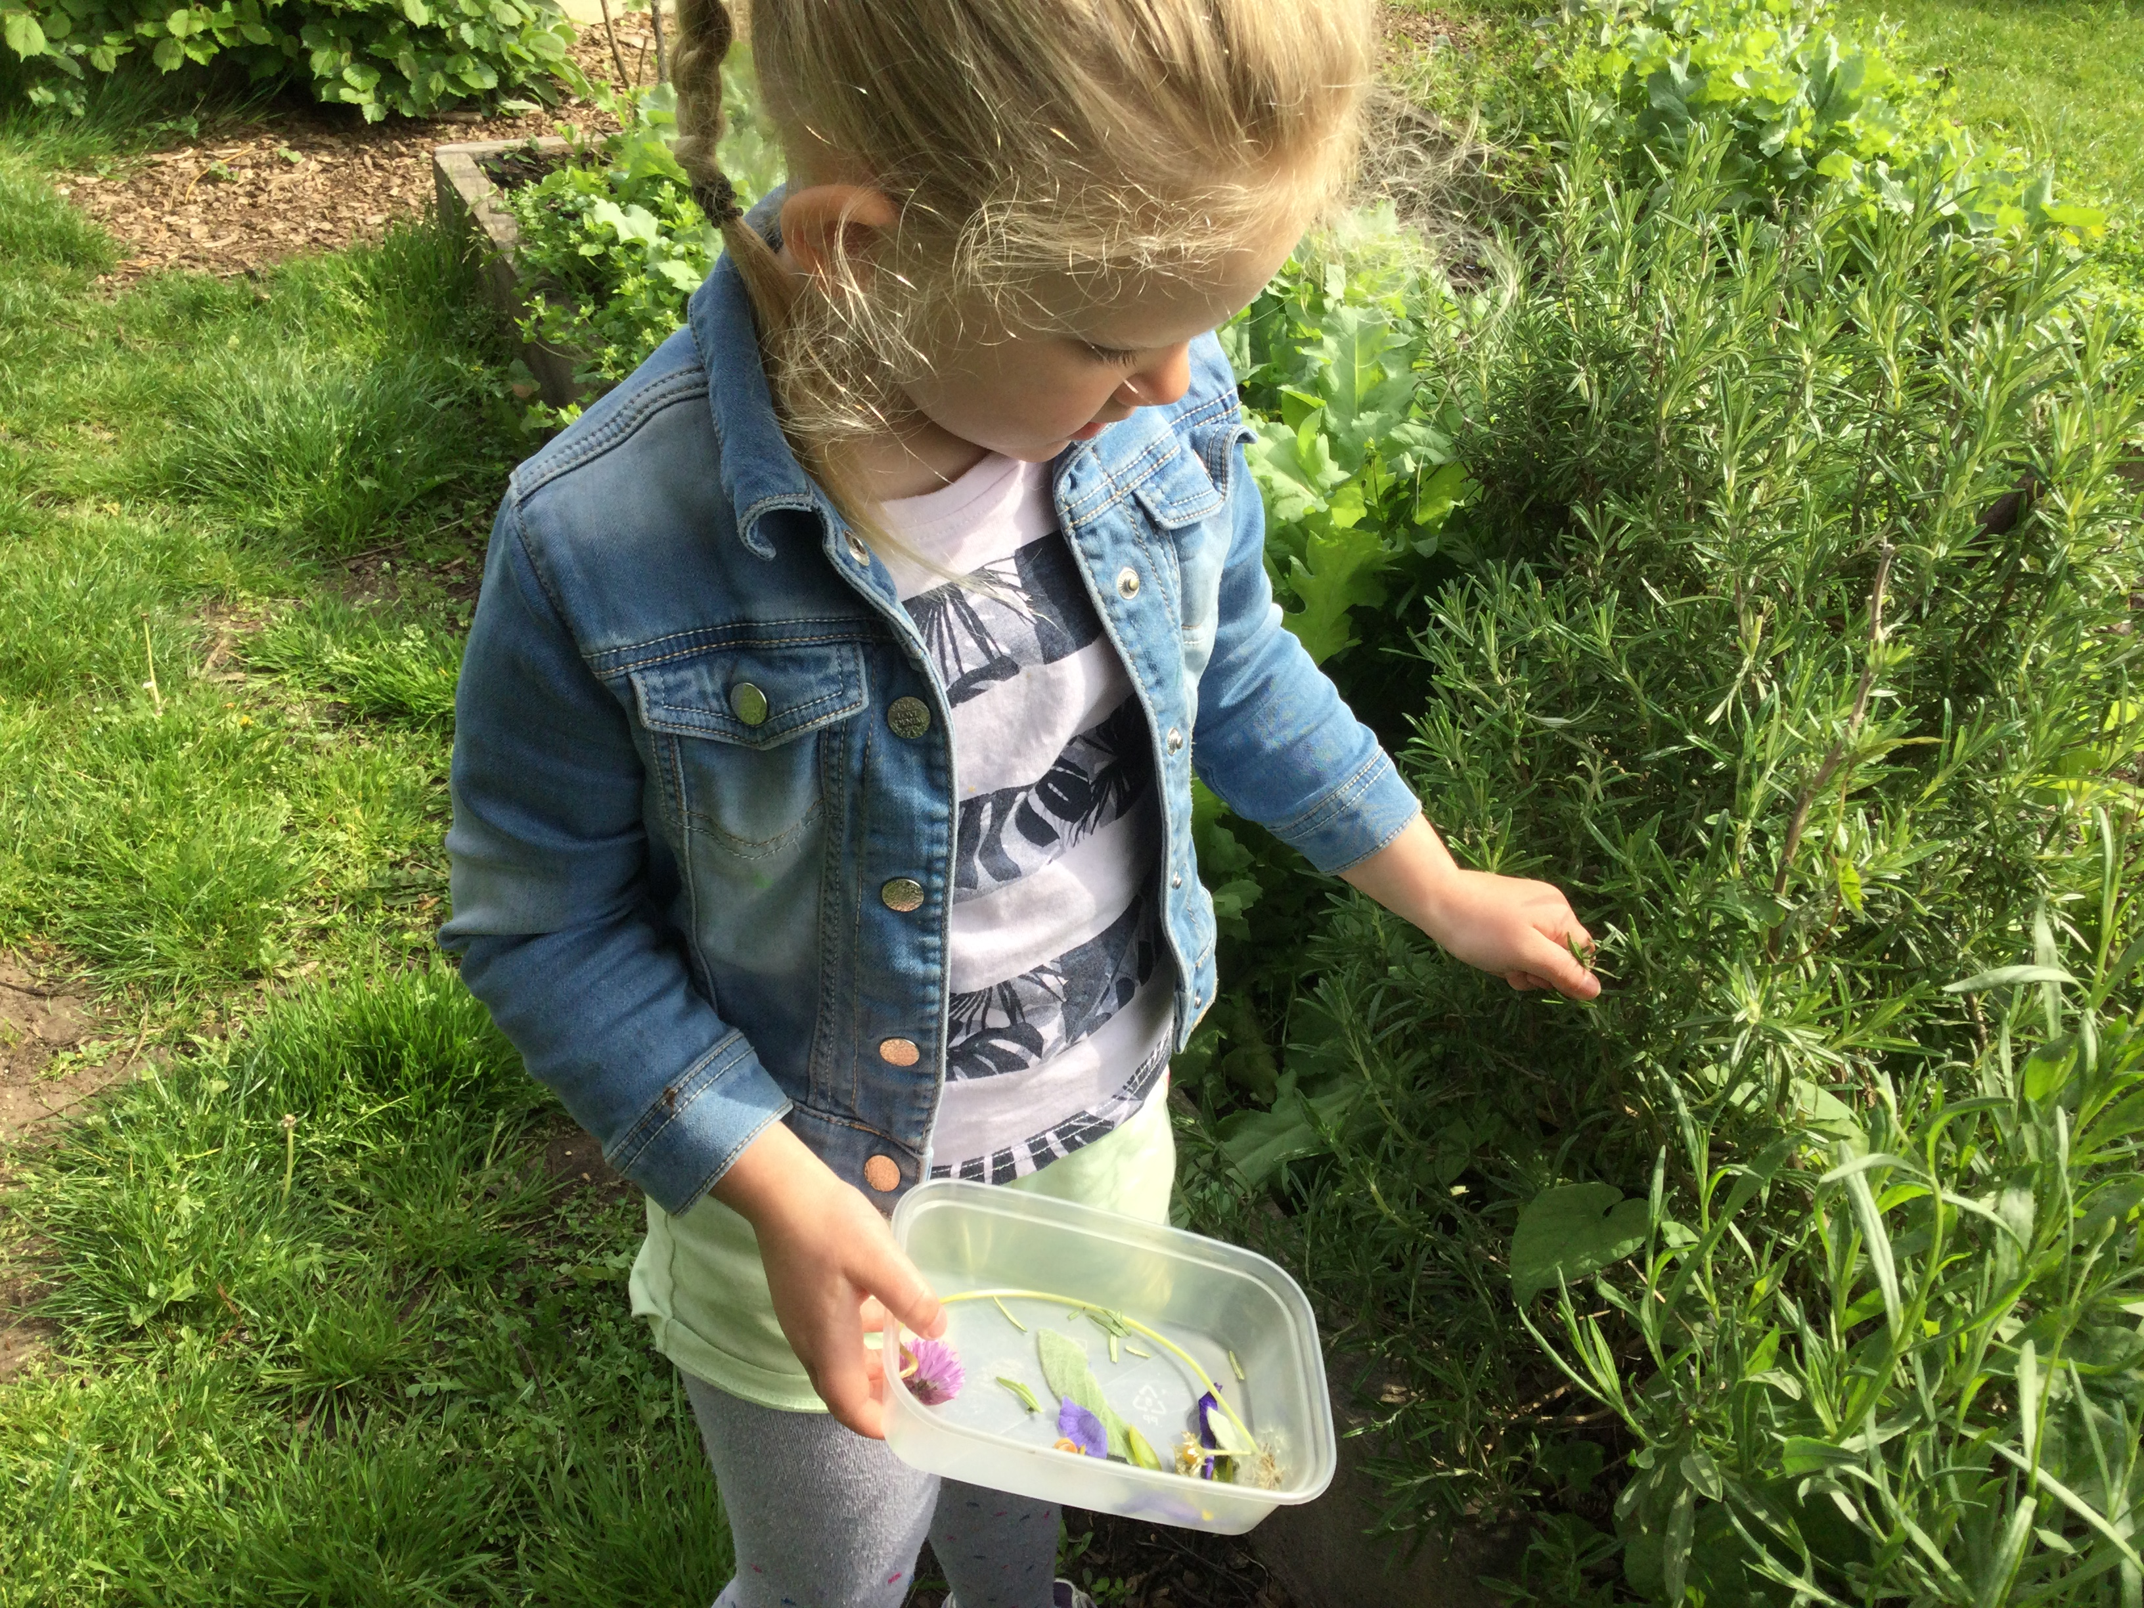
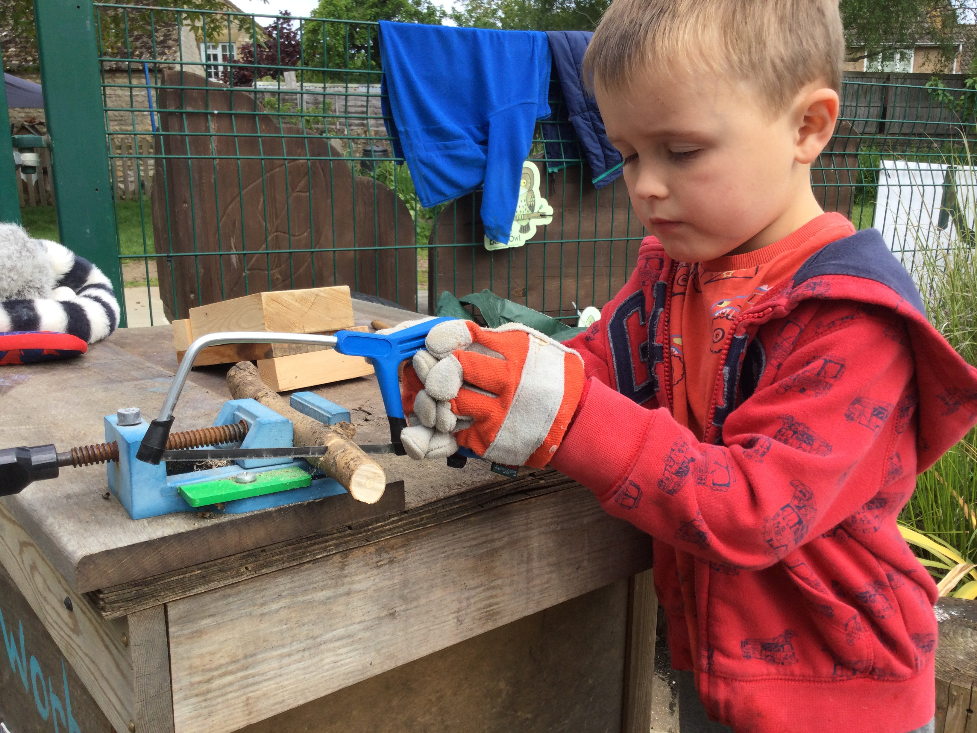
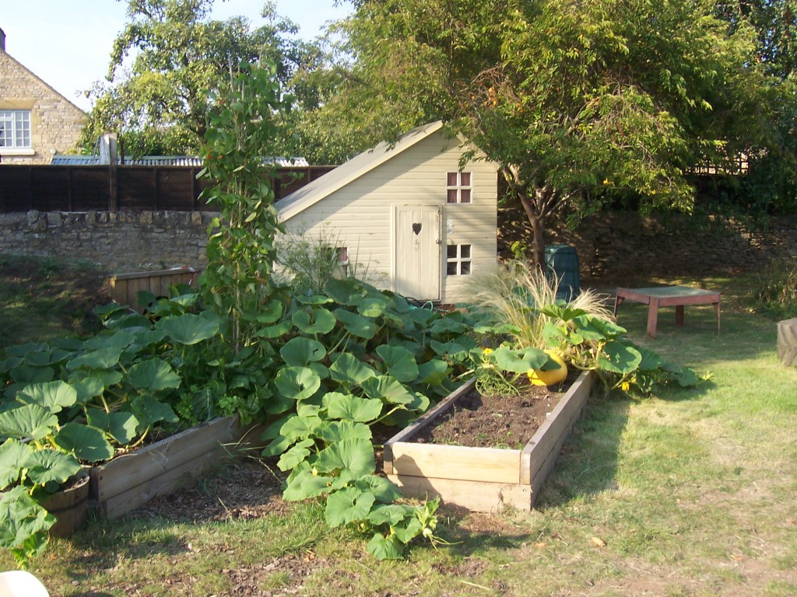
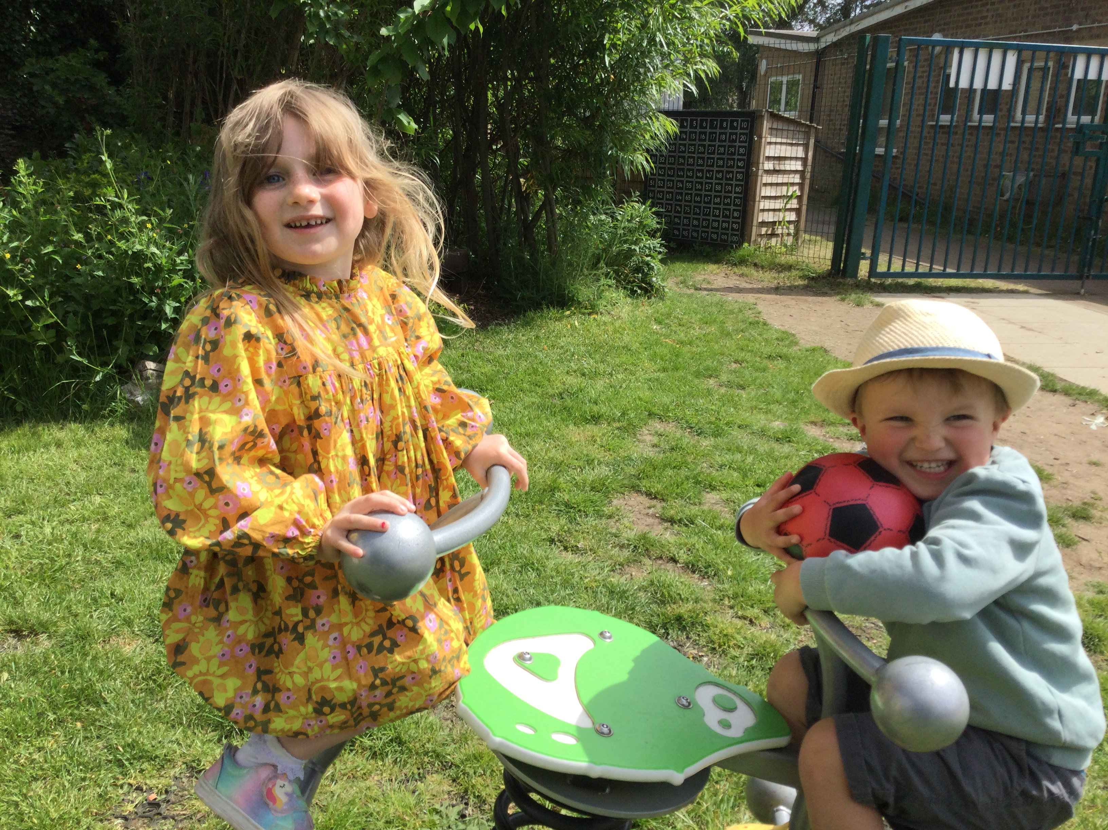
Helpston Playhouse and
Out of School Club
Welcome Book

Slide 2
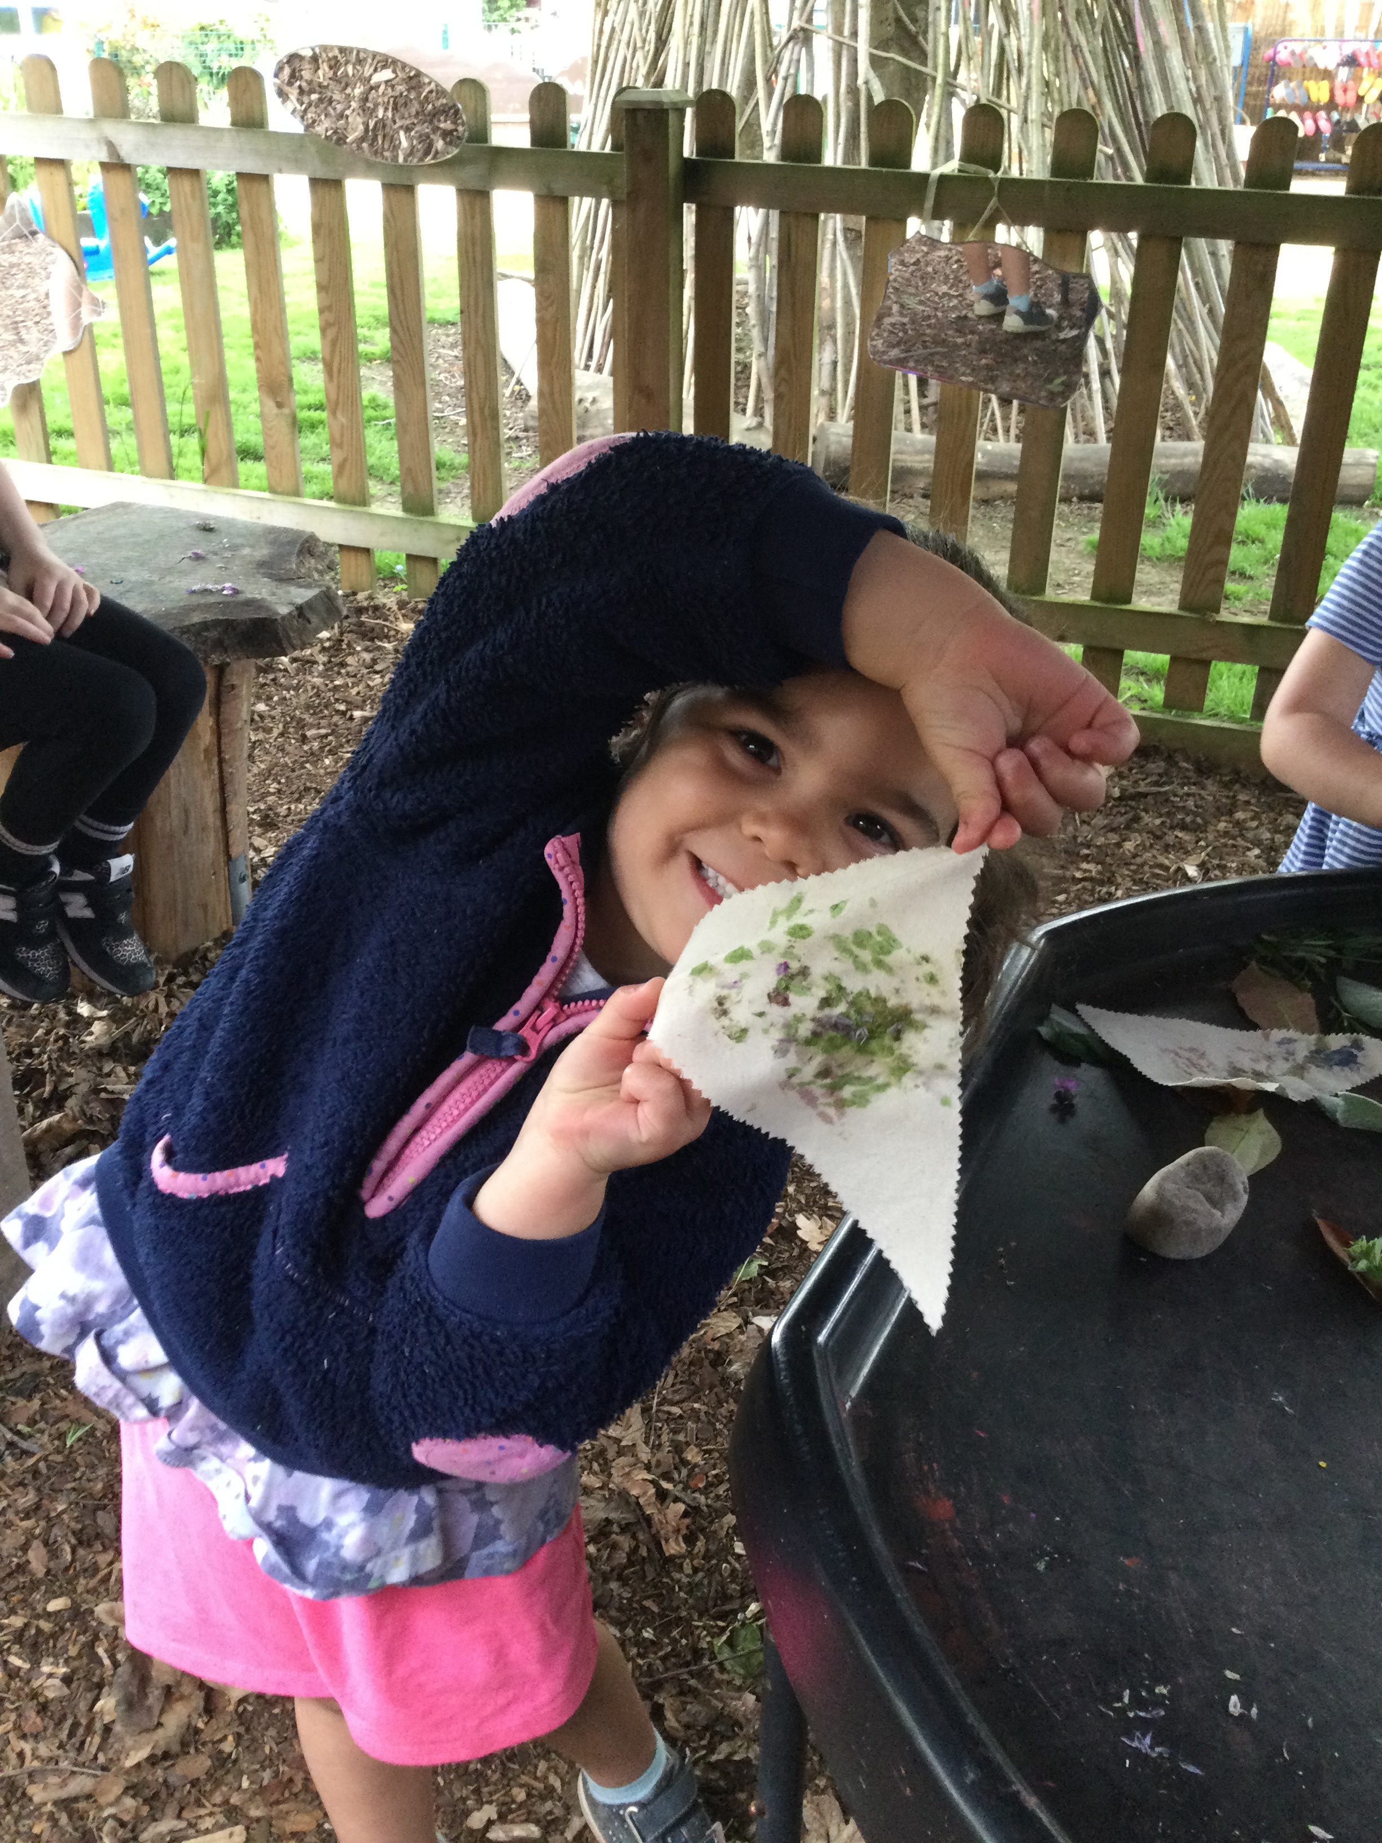
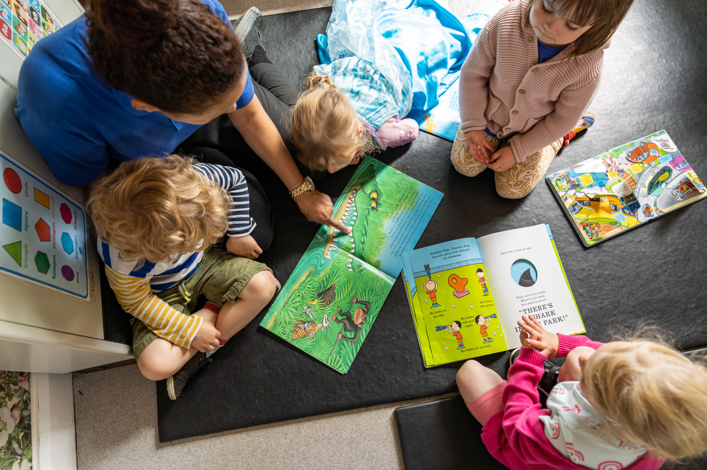
Our Mission Statement
Helpston Playhouse aims to enhance the
development and education of children by
offering appropriate play, education and care
facilities in a warm and nurturing environment.
Session Times
The Pre-School is available to children from 2 years old at the following session times:
Monday - Thursday
9am - 12pm & 12pm - 3.15pm
Or full day session 9am - 3.15pm
Fridays 9am -12pm & 12pm - 2.15pm
Or full day session 9am - 2.15pm
All Preschool sessions are £4.98
per hour.
We are a term time only setting.
Also available to you are our
popular Out of School Clubs (from age 3):
Early Bird:
7.30 - 8am @ £2 per child
Breakfast Club:
8am - school start @ £4 per child
After School Club:
2.30/3.30-5.30pm @£4 per child per hour

Slide 3
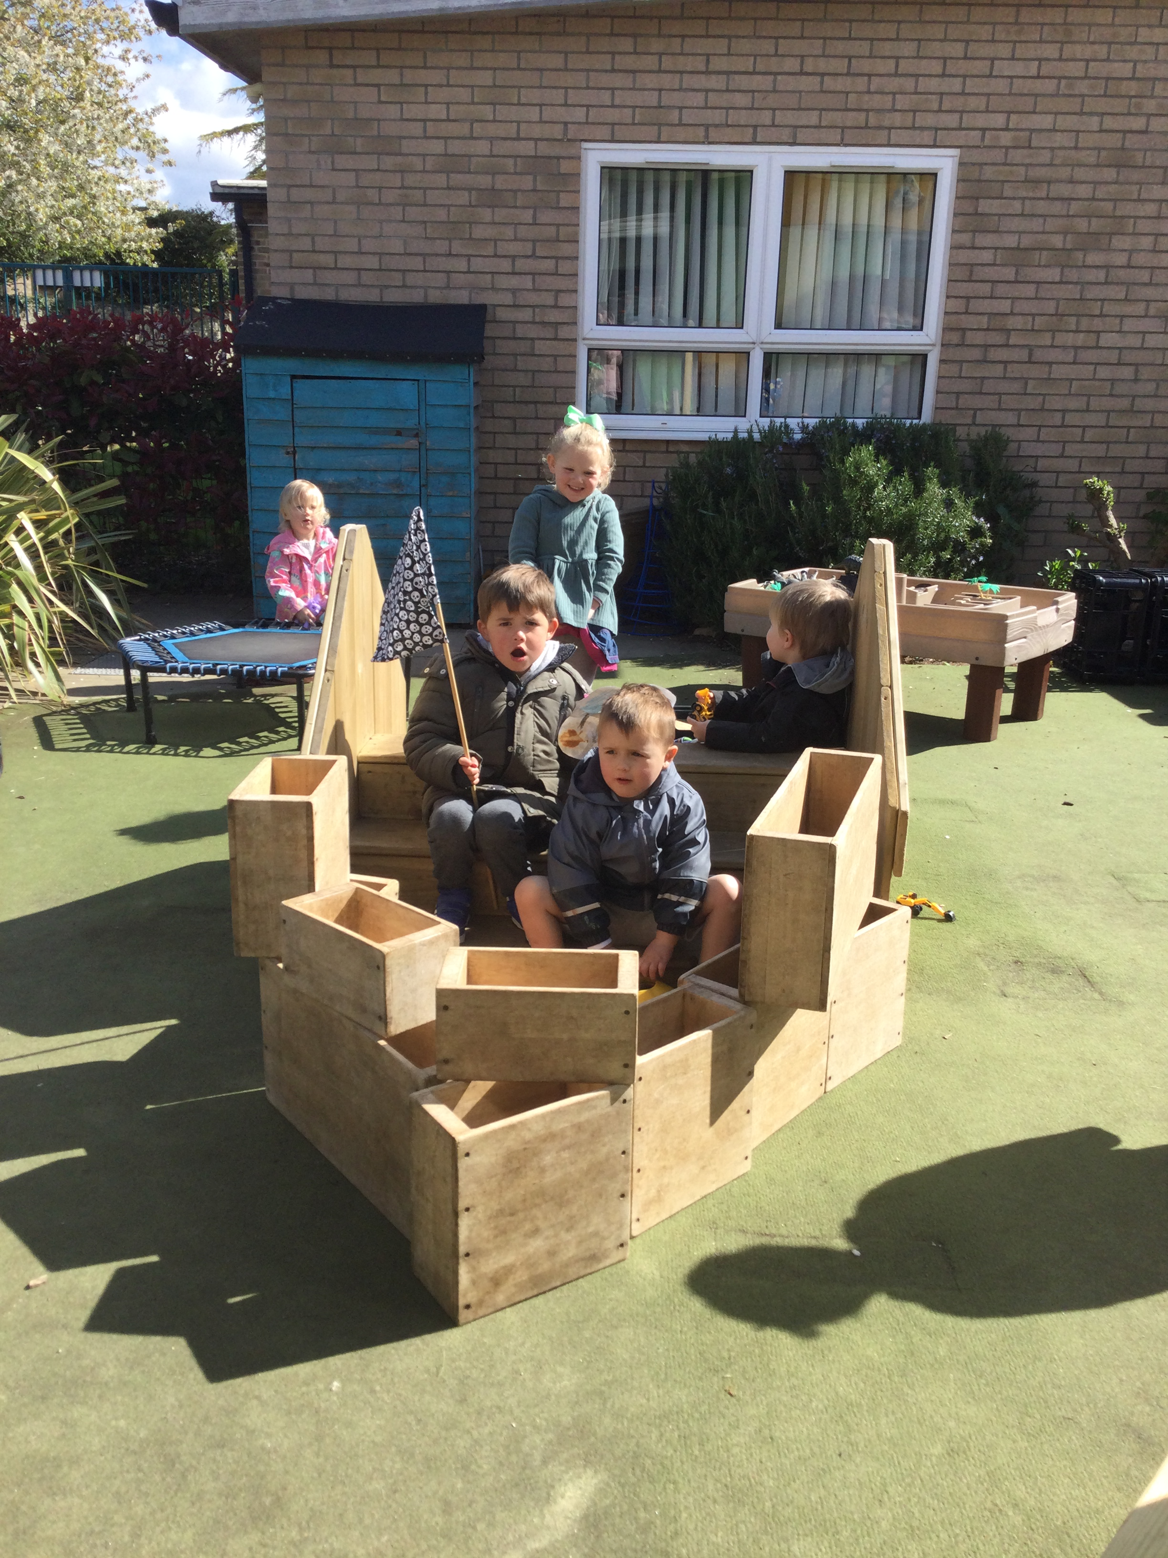
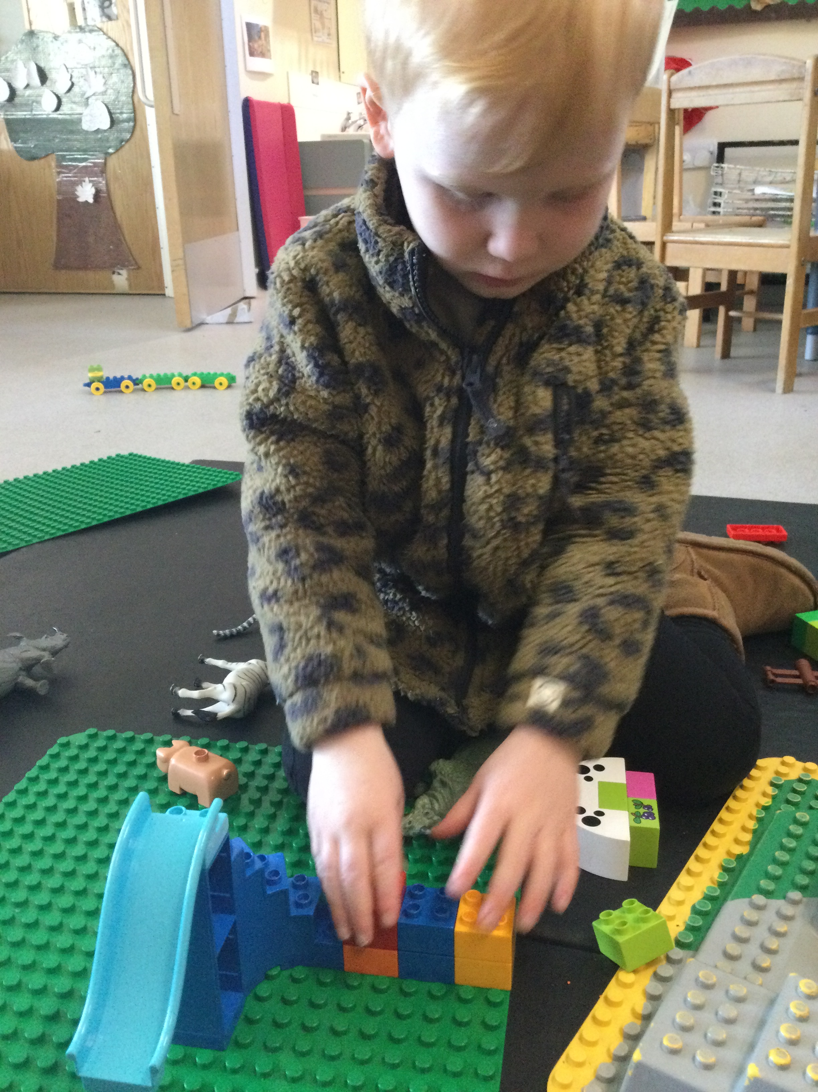
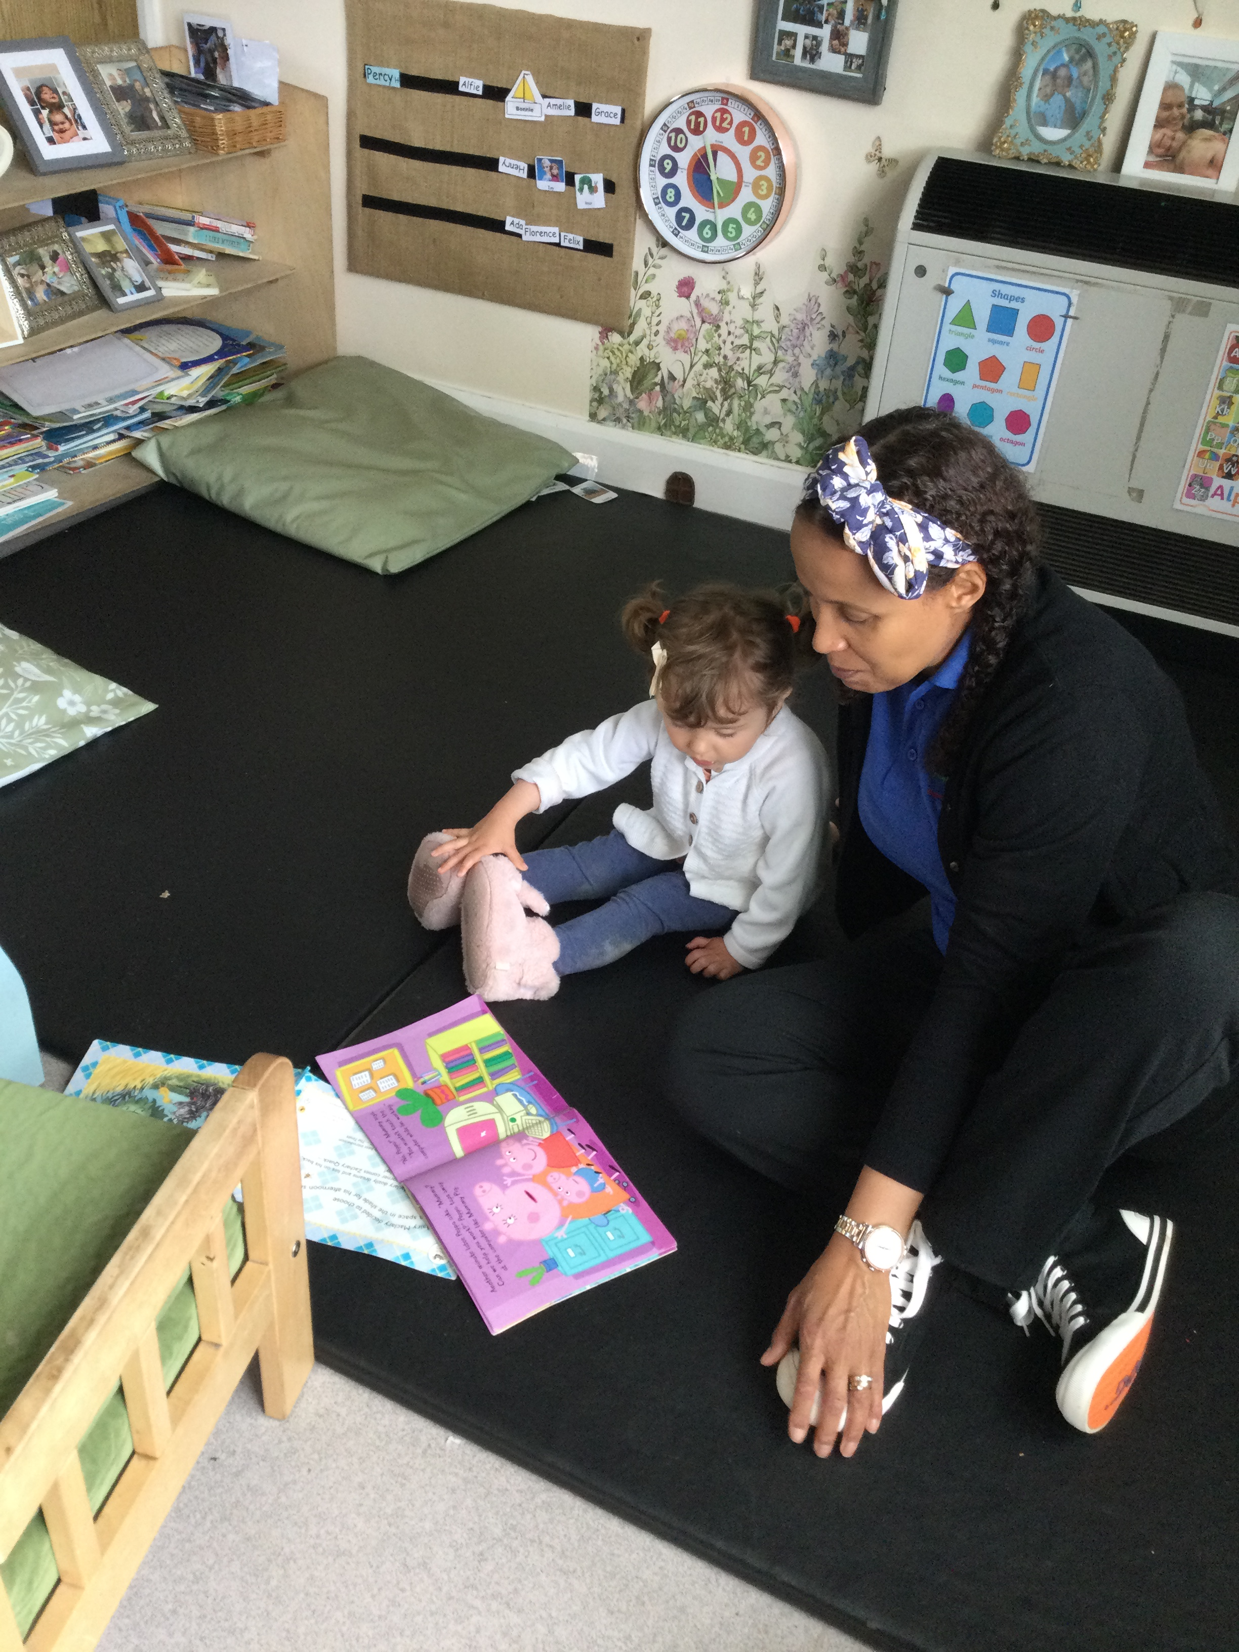
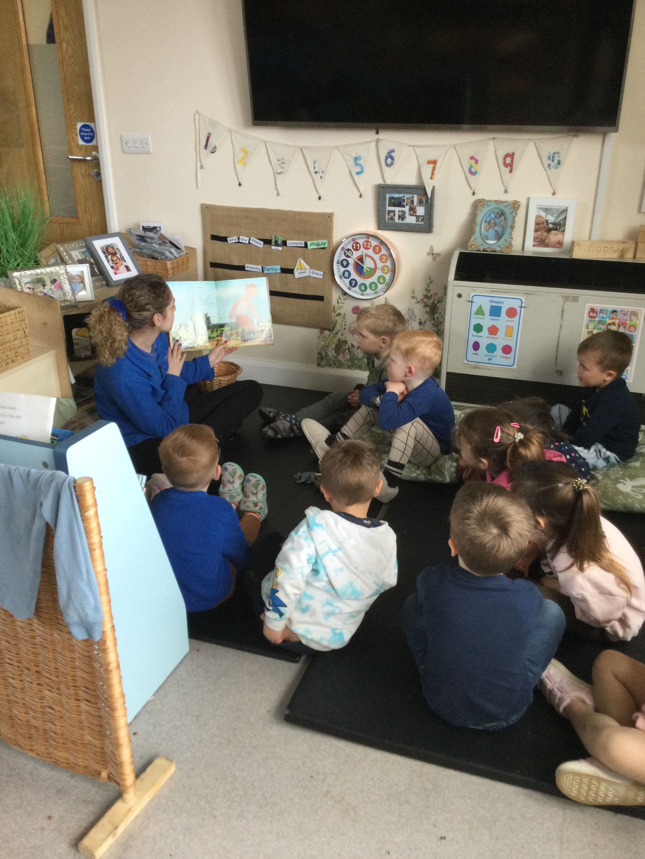
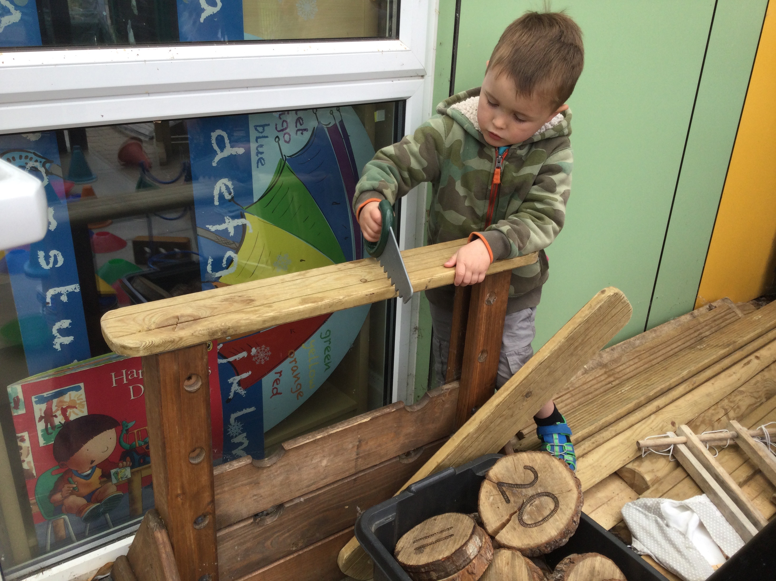
Such a lovely pre school! The staff are so caring and really get to know the children well. The activities and resources they have are outstanding. For me, I absolutely love the outside space they have and the importance they put on playing outside and doing fun activities.
RB
A wonderful setting, with friendly, professional, welcoming staff. My eldest daughter loves the breakfast club and my youngest daughter has settled well into pre school.
I couldn’t recommend it enough!
GT, mum of 2
We provide the 30-hours or 15 hours of government funded childcare places for working parents of three and four year olds, and for eligible 2 year olds.

Slide 4
Your Child
We are here to support and encourage your child and to work with you to settle your child/children quickly and happily within our setting.
Settling-in visits
We arrange two settling in visits:
The first visit will last for 1 hour, with parental support.
You will be greeted by your child’s key person so that you have immediate support from day one.
The second visit will last for 2 hours. We initially ask you to stay until your child is settled then depending on your child’s views and feelings, you can leave them for the rest of the two hours, as long as your child is happy for you to do so.
We are extremely flexible. If your child needs further settling in visits we will increase them until your child is happy, confident and relaxed.
Key Person
Your child will be allocated a key person before their first visit. The key person approach gives every child the reassurance to feel secure and cared for, helping them to become familiar with the Pre-School environment and to feel confident and safe within it. We recognise every child’s individuality, efforts and achievements and believe that relationships between adults and children are crucial for the child’s happiness and well-being.
Home to School Book
When your child starts you will be given a “Home to School” book. This is a communication line between your child’s key person and you as a parent, this will help us share information regarding anything we and you feel is appropriate. Please deposit the book into the tray provided each morning for the key person to access.
Sickness
Please contact the Playhouse if your child is unable to attend a session. If your child has a sickness or diarrhoea please leave a minimum of 48 hours after the last bout before returning them to Pre-School or Out of School Club.

Slide 5
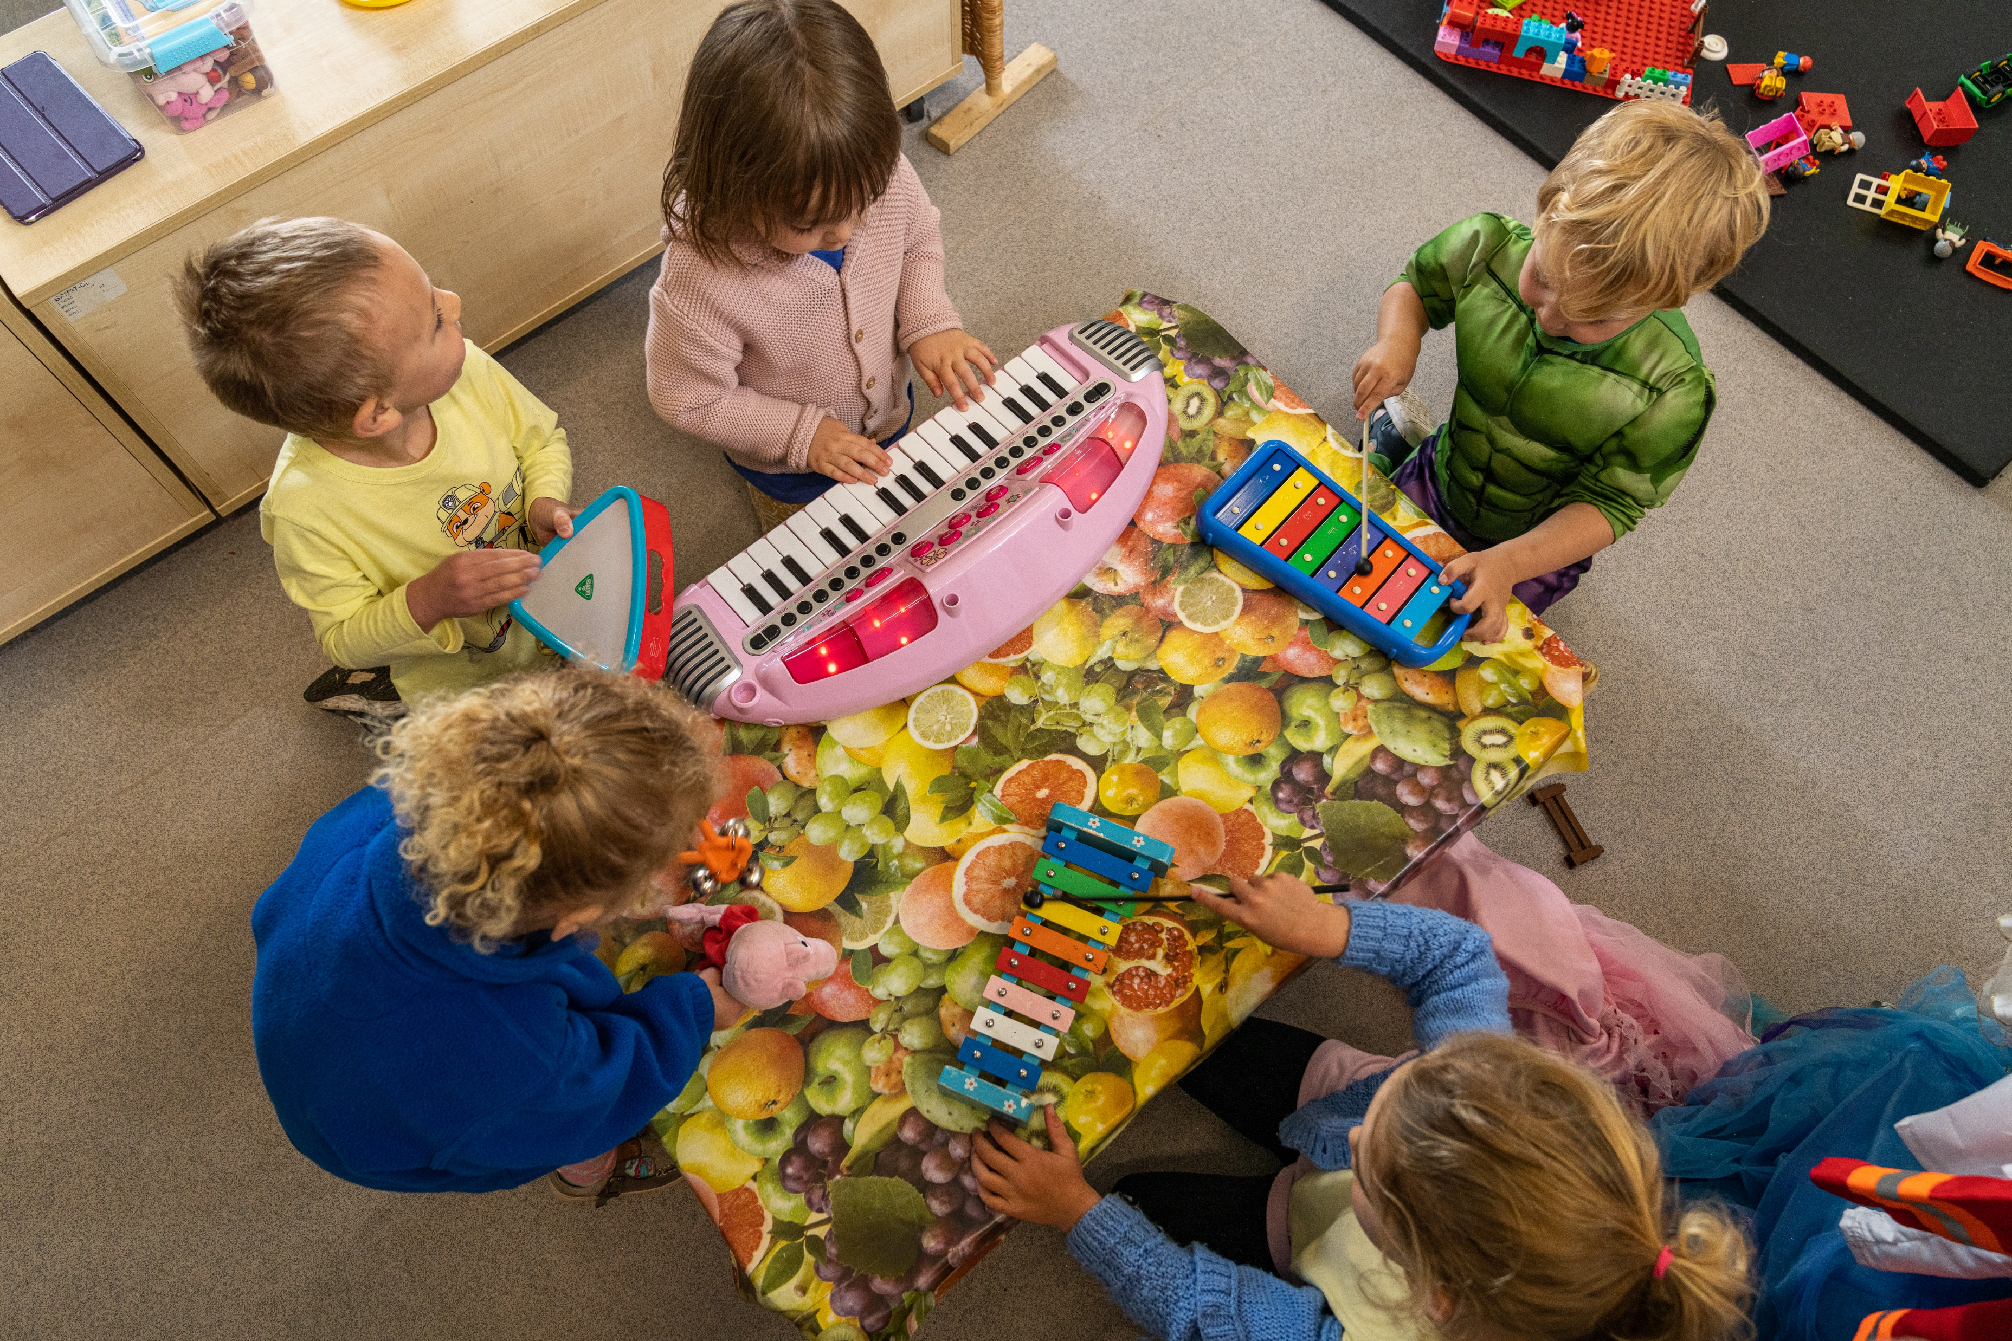
Your child’s learning journey
All practitioners observe all children in the setting daily using a variety of both written and photographic observations. If a child is aged between 2 and 3 we will also complete a progress check at ‘2’ in the 3 prime areas: personal, social & emotional, physical development, communication & language. All observations are shared with the parent via Tapestry and help obtain a clear picture of the child’s needs and how to plan at both the setting and at home.
We also plan using Personal Or Possible Lines of Development (P.L.O.Ds) at least every 6 weeks to define what interests your child, and how we can use that interest to support your child. We analyse this information to assess how your child is developing and learning, and use this to plan weekly activities that will enhance your child’s play, develop their skills and to complete each child’s individual ‘learning journey’.
It is crucial we discuss, share and involve parents as you know your child best! By doing so we can obtain a full, rounded picture of your child and this helps us understand how we can support their development with the cooperation and understanding of all parents. We share this information with you using our ‘home to school’ books, Tapestry and one to one meetings with your child’s key person. We also meet with you for Summary 1s, a final summing up and Summary 2s at the end of the summer term for all children moving up to school in September.
Each of the seven areas of learning and development are broken up into the following bands for development: Birth – 11 months, 8-20 months, 16-26 months, 22-36 months, 30-50 months and 40-60 months including Early Learning Goals. You will notice in your child’s folder these age bands mentioned on their observations; this is to help you plot your child’s development, but please note the age bands are guidelines only and not fixed with many children overlapping several stages. EYFS guidance is also used by schools during your child’s reception year.
At Helpston Pre-school we are always available to discuss your child’s needs and development. If you require further information on the EYFS or how we plan and observe please feel free to talk to us or make an appointment.

Slide 6
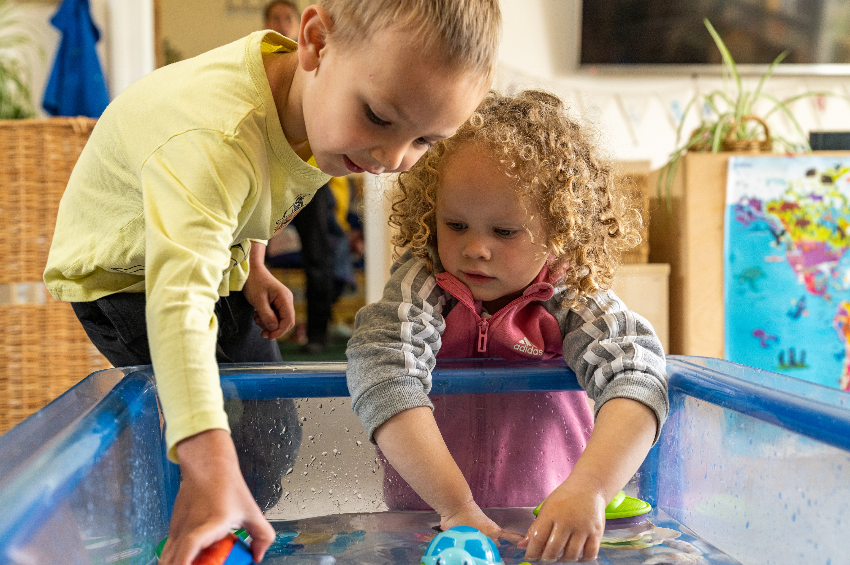
Daily routines—Preschool
We encourage our children to become independent, although of course we help when they need it!
9.00 In the cloakroom, children change outdoor shoes to their slippers, putting their shoes away in their drawer, and hanging up their coats and bags on their assigned peg.
Children place their water bottles and home folders into the correct trays inside the main room, and put their sharing toy into the Home basket.
9:10 Circle time - we do the register, days of the week song, and talk about who has brought what in for the sound of the week.
9:20 Session start - free flow which means children are able to access inside and outside.
Activities are set weekly but adapted to the child's choice and they can also take things out of drawers and off the shelf, which gives them free choice.
Snack is available until 10:30.
11:30 tidy up
11:40 Story Time - singing, musical instruments, ring games, parachute, phonics (Silly Soup) cosmic yoga etc
12:00 Lunch time - packed lunch or hot dinners
Session starts again after lunch and new games and
activities are set out.
2:50 Story time
3.15 Preschool session finishes

Slide 7
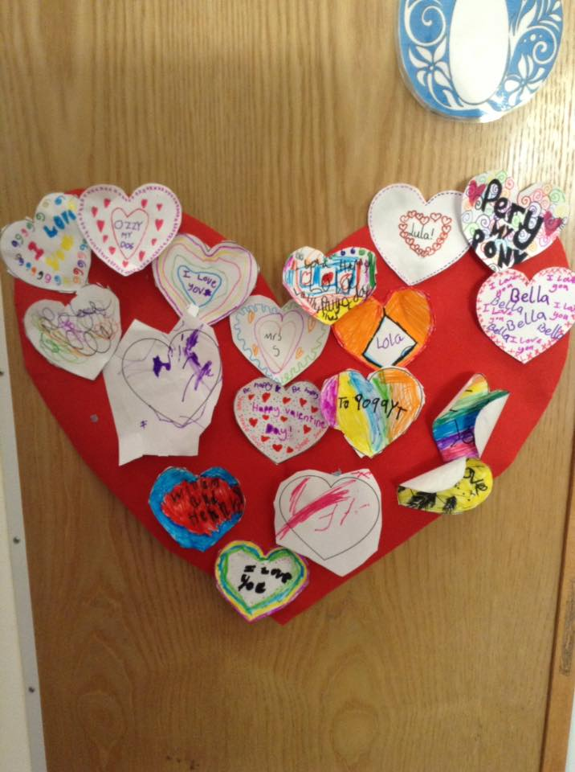
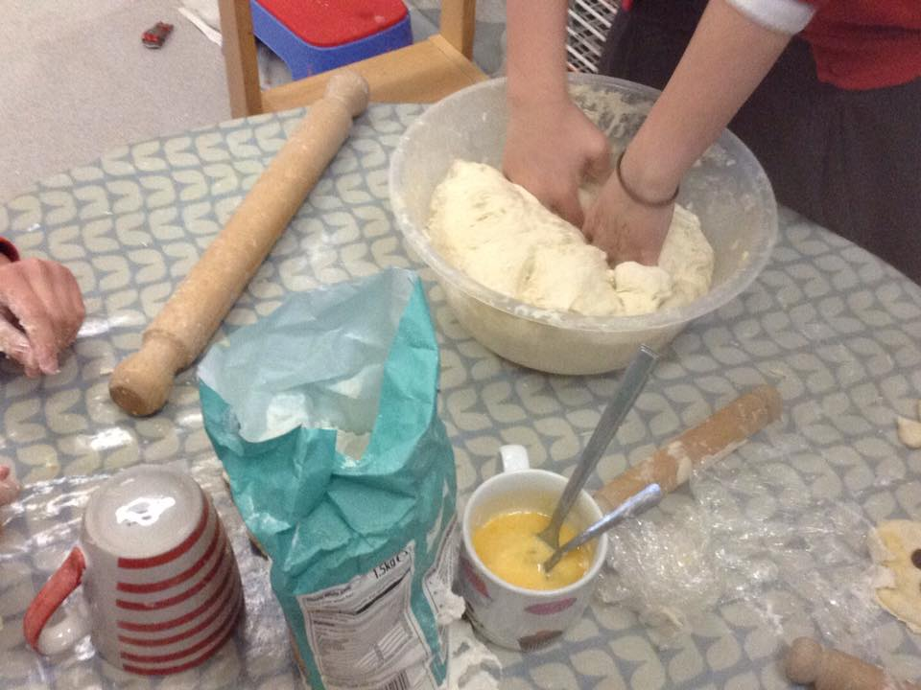
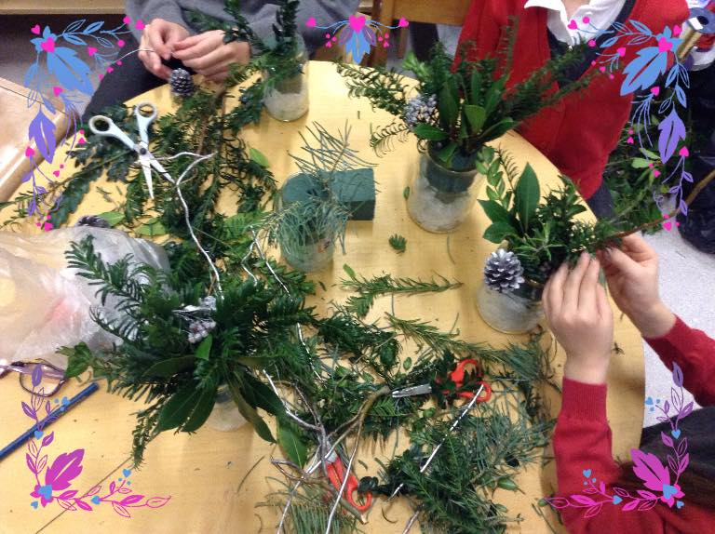
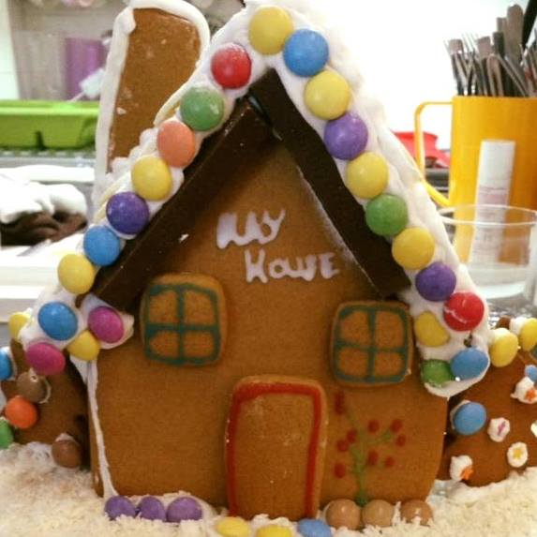
Daily Routines—Out of School Club
Early bird 7.30am - 8am Breakfast Club 8am - school start Children are able to access breakfast and all the toys are available to them.
Children are taken over for school ready for the start of school.
Out of school club 3.30pm - 5.30pm close (2.30pm Fridays)
Reception are collected via the linked corridor, which helps the transition to be calmer and less overwhelming.
Years 1,2,3,4,5,6 are collected in the main corridor of the school and sign in on the register and then brought over.
Children can access inside and outside of the Playhouse.
Snack is available 3:45/4:00pm
Children are able to choose their own activities. There is a new adult lead activity every day.
Children are picked up at differing times throughout the evening; we close at 5.30pm.
Helpston Playhouse Preschool and Out of School Club

Slide 8
‘Wow leaves’ are a way to celebrate your child’s achievements within
Pre-School. We feel this is another positive way to bind and celebrate the home/school relationship with your child.
The completion of ‘Wow leaves’ can be undertaken by parents, carers, grandparents, relatives and childminders.
Wow leaves will also be completed in Pre-School as well, and added to our Wow Tree inside the Pre-School. They will be added to your child’s learning journal, and the information we gather from them are a valuable source of evidence when completing your child’s learning journal.
Here are some ideas of what we’re looking for, but, we’re sure you can find lots more examples of ‘Wow’ moments!
Being helpful
Riding a bike for the first time
Sleeping all night
Eating all of their tea
Tapestry
We use an interactive learning journal called Tapestry within the Playhouse. You will be able to access Tapestry allowing you to be involved within your own home. Observations are carried out within the Playhouse by using an ipad; a practitioner will carry out an assessment and it will go instantly into your child’s online learning journal.
You will also have the opportunity to add any wow moments that you feel would be of benefit for the learning journal. Children are constantly learning, so please do not feel afraid to add information to their journal, and do comment on our posts! By adding observations we can see what your child enjoys, allowing us to extend what you have been doing.
Please be assured this is safe and secure, and the only people who are able to have access to your child’s journal are staff and yourself.

Slide 9
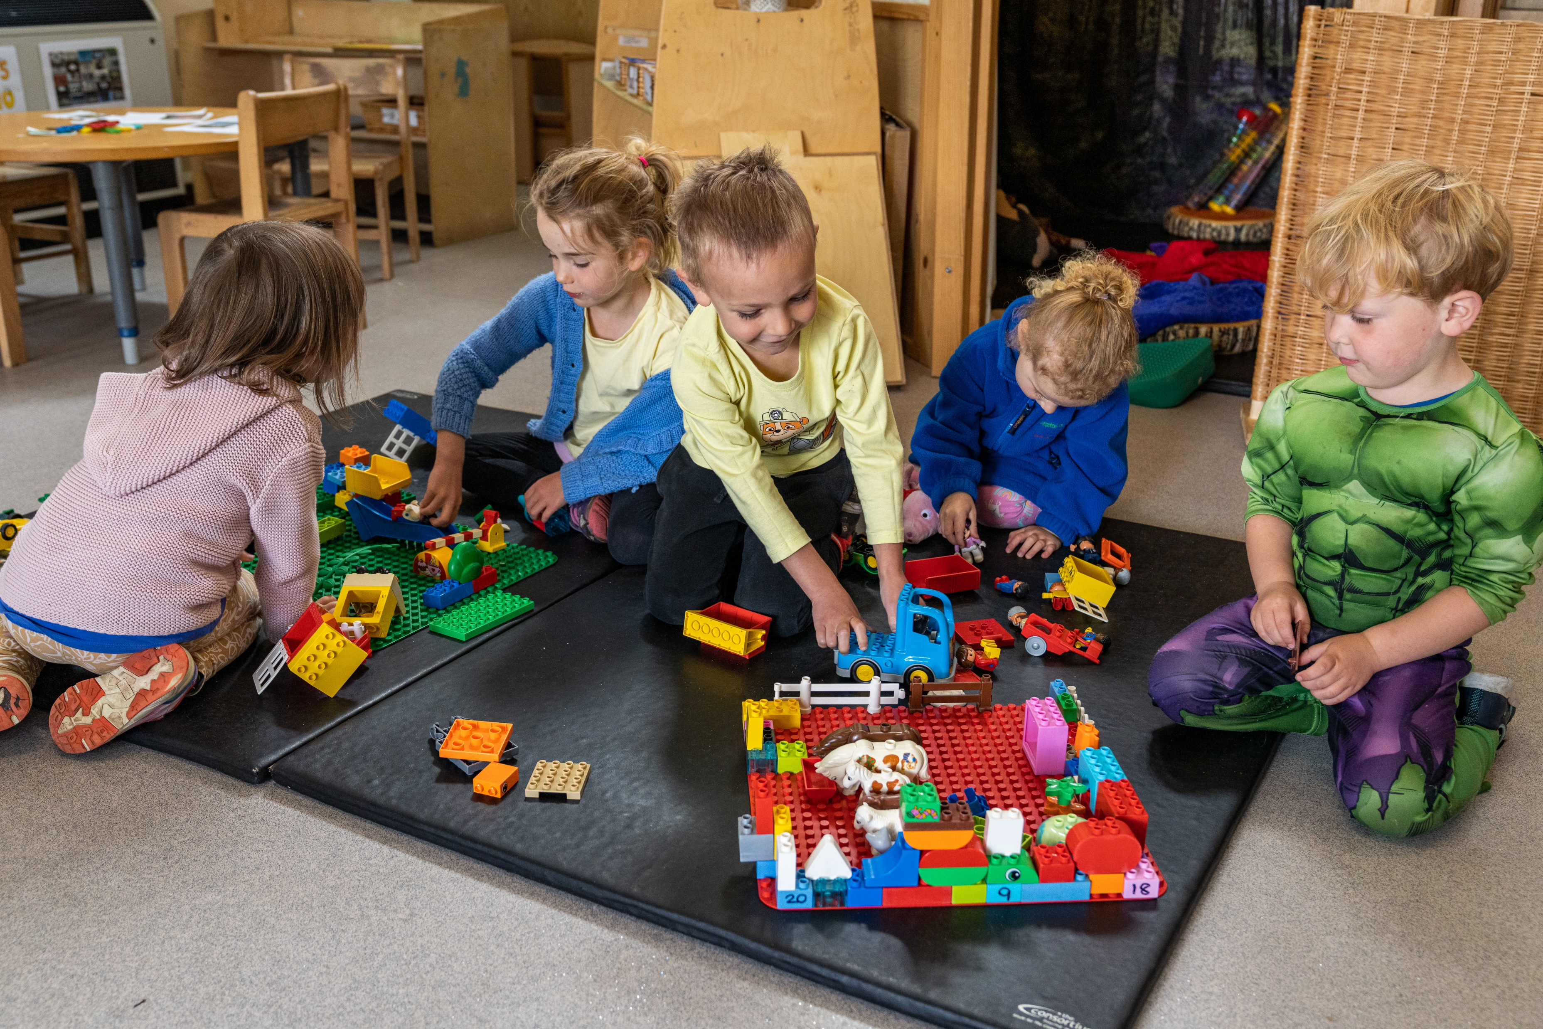
Meals
Snacks
All children are provided with a varied and healthy snack during the morning session with a drink of either milk or water.
Lunch
Lunch is taken all together in the Pre-School, whether hot dinners or packed lunch. Hot meals are provided by John Clare Primary School and cost £2.50 per day which includes a main course and a pudding. The menu runs on a 3 weekly rota which changes seasonally and is provided in advance. School dinners are booked a week in advanced with payment.
Out of School Club
Drinks
To encourage children to drink plenty of fluids we ask you to provide a fresh bottle of water (not juice) every day they attend.
Breakfast
A variety of breakfast cereals are on offer as are fruit and toast.
Afternoon Snack
A comprehensive choice of healthy hot snacks are available on a rota. To engage the children, their feedback and suggestions are taken into account when producing these. Fruit, toast and cereal is offered as an alternative for those who choose not to have this. This snack is served at 4:00.
This setting is a Nut Free environment.

Slide 10
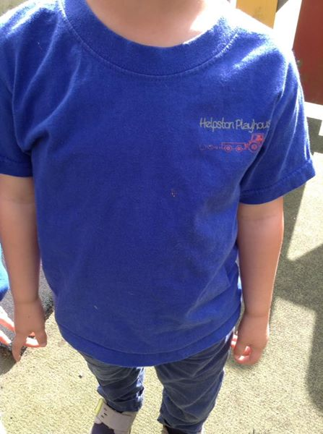
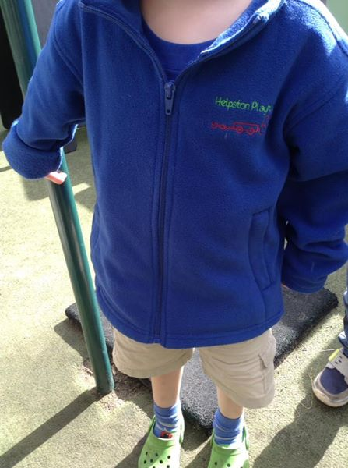
Please provide...
To enable your child to fully enjoy their time with us we ask you to provide (all named):
weather appropriate clothing
indoor shoes or slippers
spare clothing
water bottle
Where Required
Nappies/wipes/nappy bags, cream etc… Packed lunch in named bag or box
Also…
Summer: Sun hat and also sun cream Winter: Coat, wellies and waterproofs
Please send your children in clothes that you don’t mind getting dirty as we encourage learning through messy play.
We do have a Pre-School uniform; blue polo shirt and blue fleece with our Playhouse logo. These are available to purchase from the Playhouse. You can order a sunhat direct from our suppliers, if you would like one!

Slide 11
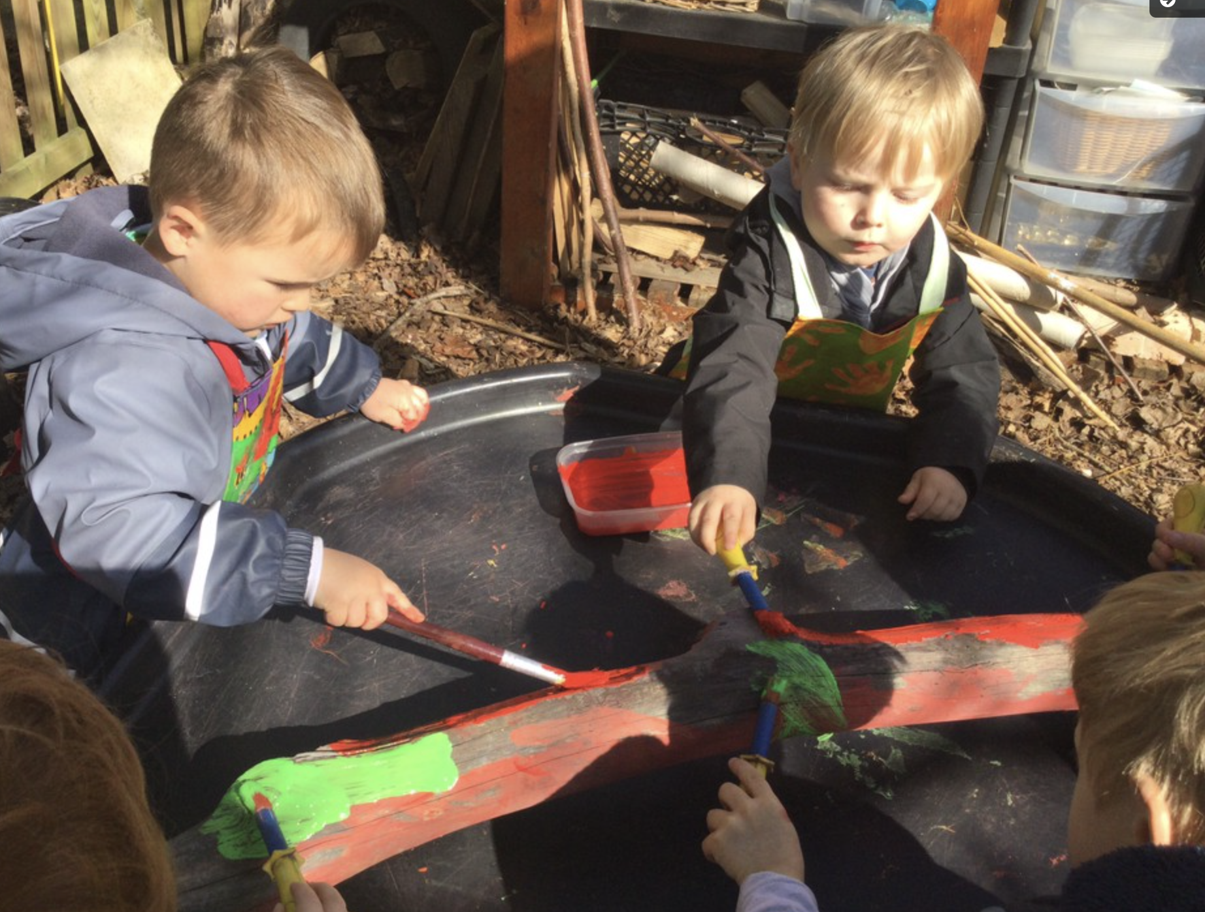
Weekly Updates
Playhouse and OOSC
We issue a Weekly Update for both the Playhouse and the Out of School Club! Within the update we give you an overview of the week’s activities, details of planned activities for the following week, upcoming events and dates for your diary, and any other important news.
We issue the updates to you via email on a Friday and they can also be found at our website: www.helpstonplayhouse.org.uk
Forest School
We are lucky enough to be able to offer our own Forest School at Helpston Playhouse.
Children are enabled to explore our
natural resources, learn how to
handle risks, and most importantly,
develop their problem-solving
initiative, all within our beautiful,
private woodland area. Through
exploration and investigation, they
discover wildlife, work out how best
to build a shelter, and even get to
grips with woodwork tools.
Getting outside in all weathers has
proven physical and mental health
benefits, as well as helping teach our
children to be resilient – there is no such
thing as bad weather, only
inappropriate clothing! Forest School
sessions take place entirely outside
in the wood, whatever the weather.
We will provide a waterproof suit in very wet and cold weather, but it is still important that your child wears clothes that are waterproof and warm, and that are ok to get wet and muddy.
The Accelerated Learning techniques intrinsic to Forest School enable children to explore and develop self-awareness, empathy and independence.

Slide 12
Safeguarding
Safeguarding children
Our setting has a duty under the law to help safeguard children against suspected or actual ‘significant harm’. Our employment practices ensure children against the likelihood of abuse in our setting and we have a procedure for managing complaints or allegations against a member of staff.
Our way of working with children and their parents ensures that we are aware of any problems that may emerge and can offer support, including referral to appropriate agencies when necessary, to help families in difficulty.
Entry to the Playhouse is safeguarded via our secure gate entry system. Each individual parent or carer must be visually verified by a member of our team before entry is permitted on to site.
Special needs
To make sure that our provision meets the needs of each individual child, we take account of any special needs a child may have. We work to the requirements of the Special Educational Needs and Disability Code of Practice: 0 to 25 years (2015).
Our Special Educational Needs Co-ordinator is Rachel Quann.
You can find our Whistleblowing policy on our website or in our Policies folder, in the Playhouse corridor.
Policies
Our staff can explain our policies and procedures to you. Copies are available in the Playhouse corridor and on our website. Our policies help us to make sure that the service provided by our setting is a high quality one, and that being a member of the setting is an enjoyable and beneficial experience for each child and his/her parents.
Our staff and parents work together to adopt the policies and they all have the opportunity to take part in the annual review, helping us to make sure the policies enable our setting to provide a quality service for its members and local community.
Complaints: if you would like to make a complaint, please contact our manager at the Playhouse in the first instance, or the Chair of our Committee.

Slide 13
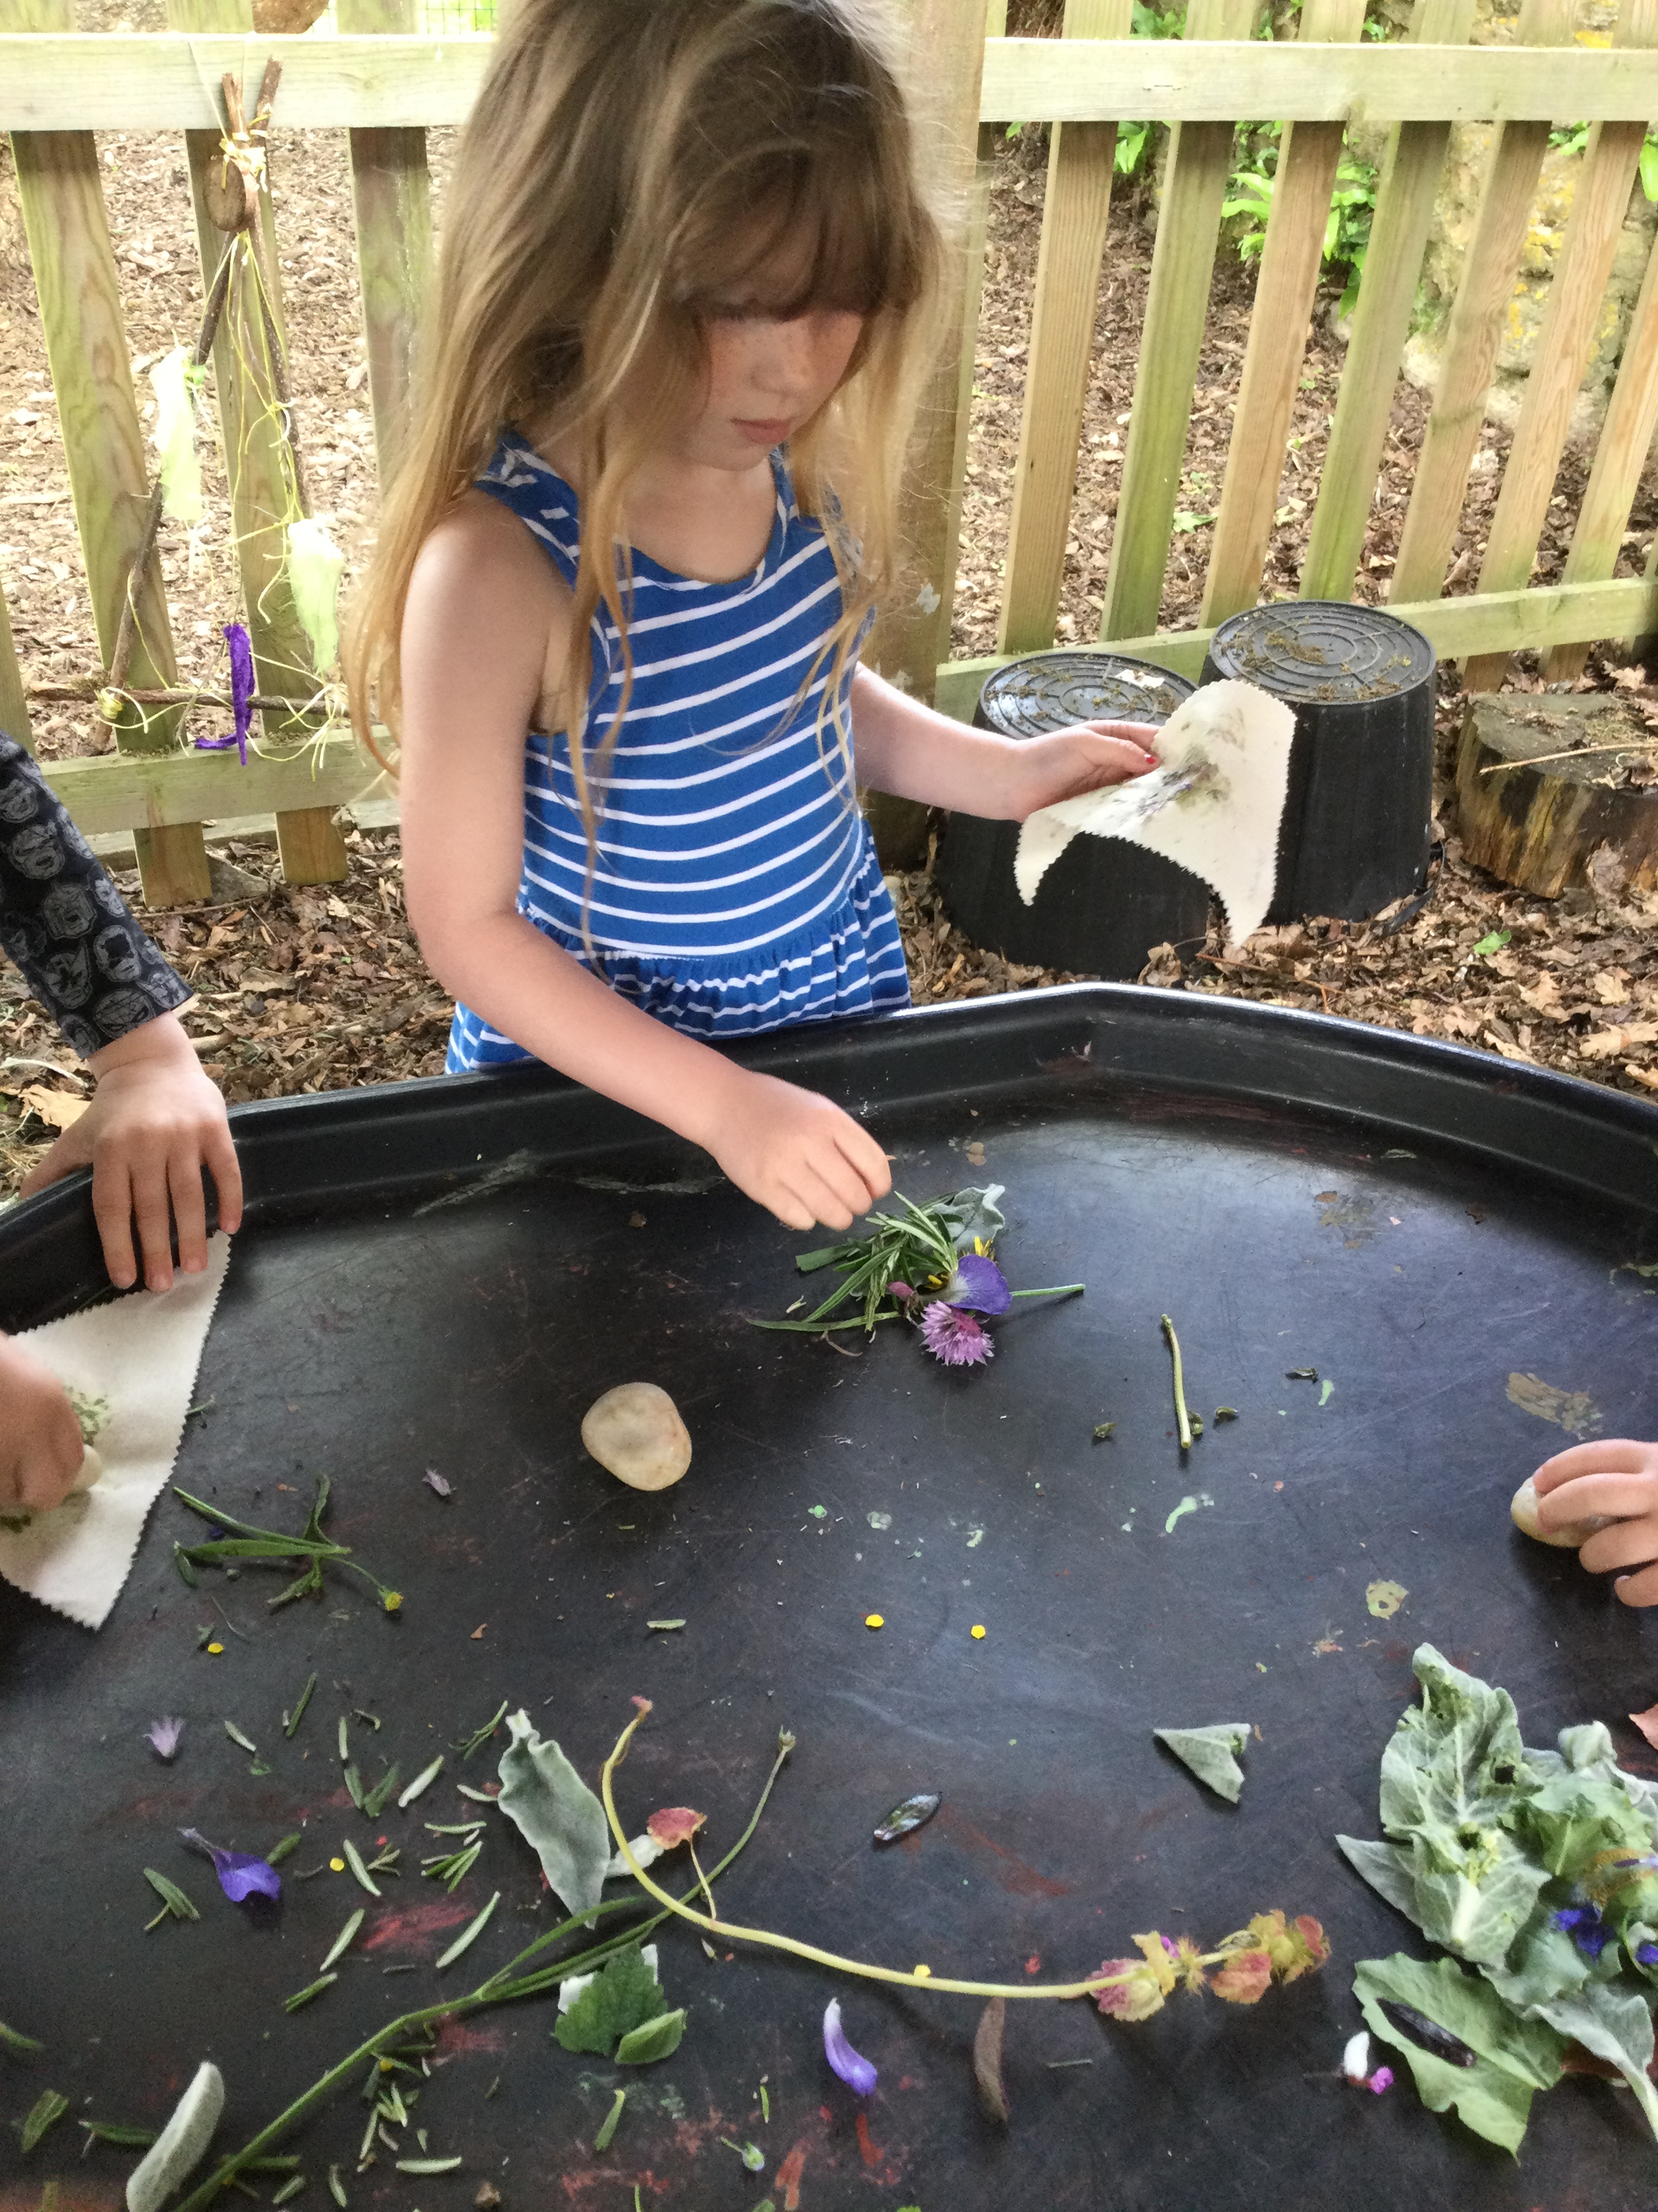
Fees
Pre-School £4.98 per hour Early Bird £2.00 per session Breakfast Club £4.00 per session Out of School Club £4.00 per hour
Late Collection Fees:
A Late Collection Fee will apply at the
Manager’s discretion when the booked
session has ended:
1. Booked session has ended and late
collection is before 5.30pm - a fee equivalent to the cost of the next session will be charged.
2. Booked session has ended and late collection is after 5.30pm – we reserve the right to charge a late collection fee of £20.00 for the first 15 minutes and £10.00 every 5 minutes thereafter.
Late Payment Fee:
A Late Payment Fee of £20 will apply when the invoice is 14 days overdue. If you are experiencing financial difficulties or your invoice payment may arrive late, please don’t hesitate to contact us.
Fees are invoiced monthly or half termly, and payment can be made by:
BACS: Send to Barclays
Sort code: 20 67 40
Account number: 53527972
Childcare Vouchers - contact our financial administrator for details
Early Year’s government funding is available for all 3-year-olds the term after their 3rd birthday. For funding information, ask our financial administrator.
Any amendments to attendance for pre-School and Out of School Club must be given in writing with four weeks’ notice.
Please contact the Playhouse if your child is unable to attend a session.

Slide 14
Data Protection
Information we hold about you and your child
We have procedures in place for the recording and sharing of information about you and your child that is compliant with the principles of the General Data Protection Regulations (2018) as follows:
The data we collect is:
Processed fairly, lawfully and in a transparent manner in relation to the data subject [you and your family].
Collected for specified, explicit and legitimate purposes and not further processed for other purposes incompatible with those purposes.
Adequate, relevant and limited to what is necessary in relation to the purposes for which data is processed.
Accurate, and, where necessary, kept up to date.
Kept in a form that permits identification of data subjects [you and your family] for no longer than is necessary for the purposes for which the personal data is processed.
Processed in a way that ensures appropriate security of the personal data including protection against unauthorised of unlawful processing and against accidental loss, destruction or damage, using appropriate technical or organisational measures.
When you register your child with us we will provide you with a privacy notice that gives you further details of how we fulfil our obligations to your data.

Slide 15
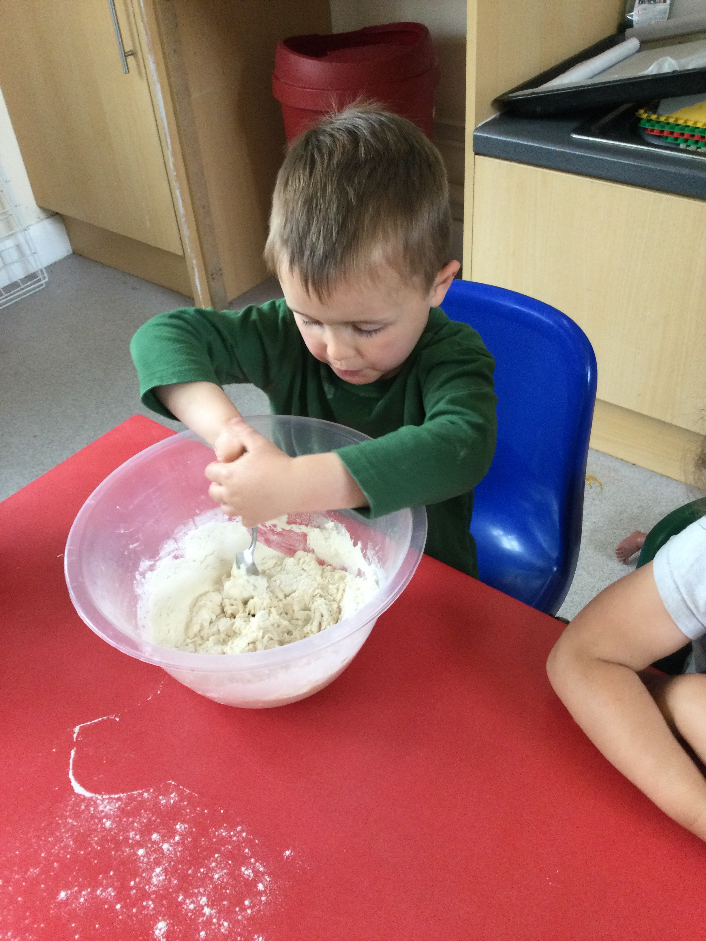
Parking
The Playhouse is situated within the grounds of John Clare Primary School, however, the car park is not for general use by parents/carers of either the school or the Playhouse.
The car park is only to be used by staff and Disabled Badge holders.
We are not permitted to use the car park for dropping off or collecting children from the Playhouse. These restrictions are in place to ensure the safety of the children coming in and out of the school, and to ensure wherever possible, staff can park within the school grounds and not impact on the surrounding residents by parking all day outside local homes.
Useful Contacts
Helpston Playhouse
John Clare Primary School
West Street
Helpston
PE6 7DU
Tel: 01733 253243
playhouse@helpstonplayhouse.com
http://helpstonplayhouse.org.uk/
www.johnclareschool.org
www.peterborough.gov.uk
www.gov.uk/early-years-foundation-stage
www.ofsted.gov.uk
Www.pre-school.org.uk

Slide 16
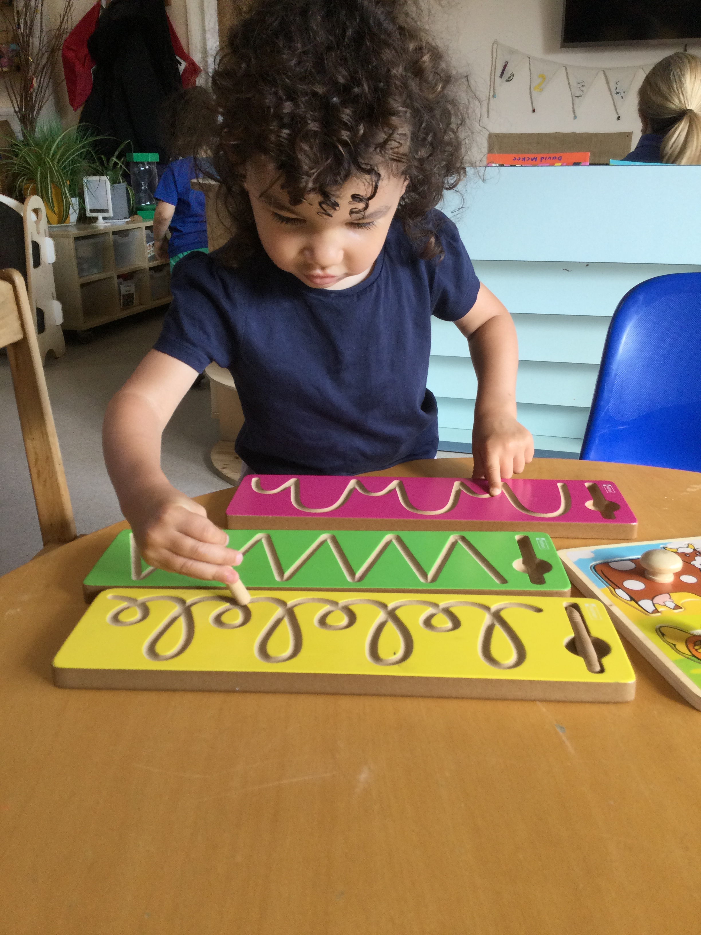
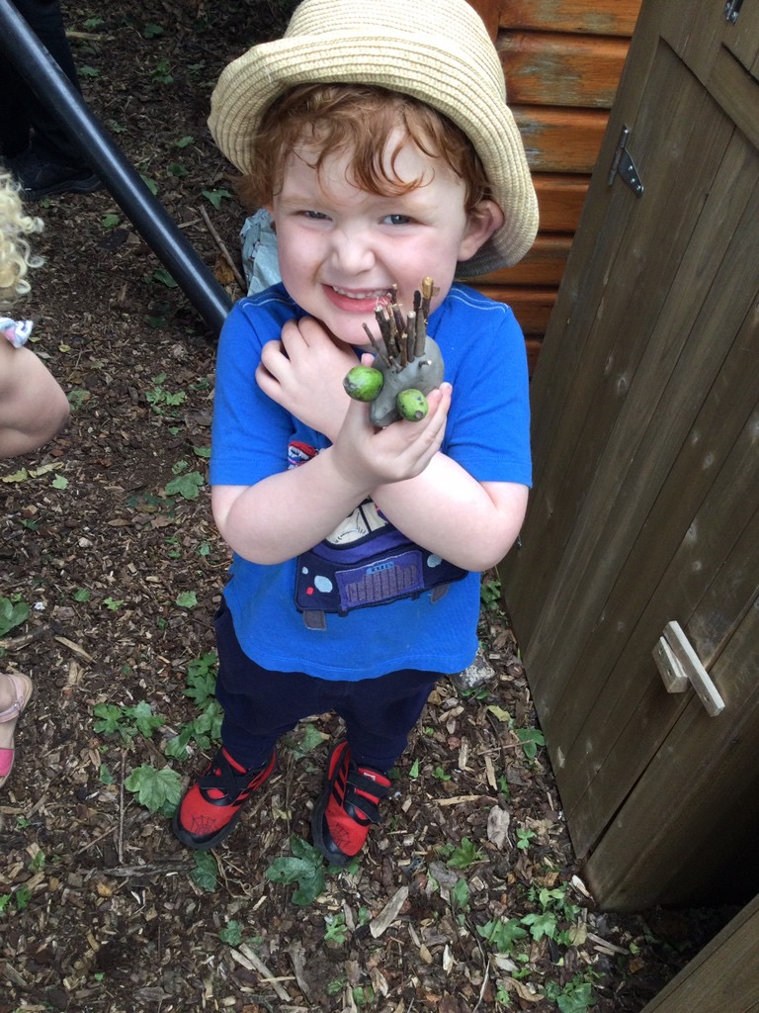
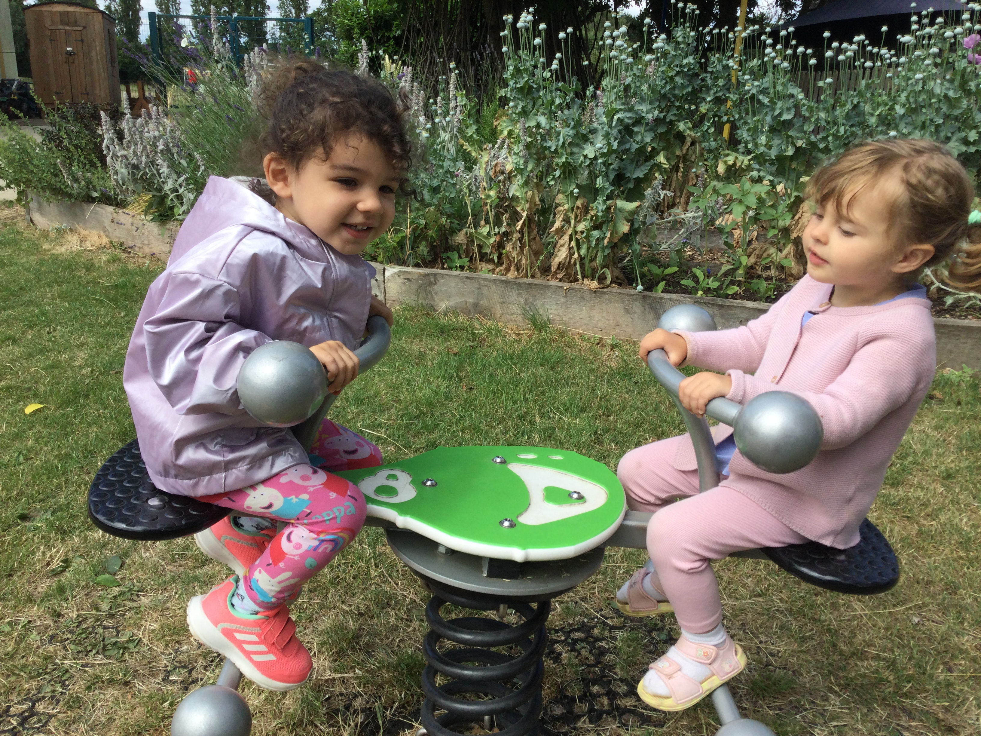
Our Committee
Helpston Playhouse is a charity run business and is managed by a voluntary led committee.
Families associated with the Pre-School and Out of School Club can volunteer to help manage the Playhouse. The committee is vital in the active running of the setting. Legally we require a chairperson, a secretary, and a treasurer. Without these three roles the setting cannot trade.
Every year at the end of September the Playhouse hold their AGM. The Chair reports an overview of all the developments that have arisen at the setting and at the end of this meeting the committee is appointed for the forthcoming year. We are always looking for new members to join the committee to help out in any way they feel they can. It’s not only parents who can join, but grandparents too. All family members are able to be part of the running of the Playhouse.
Within the committee there are additional roles aside from the Chair, Treasurer and the Vice Chair. We also have:
Head of Fundraising—a member who leads and manages a small team of committee members in arranging the planning and implementation for the various fundraising events held, to raise money to purchase new equipment for the setting.

Slide 17
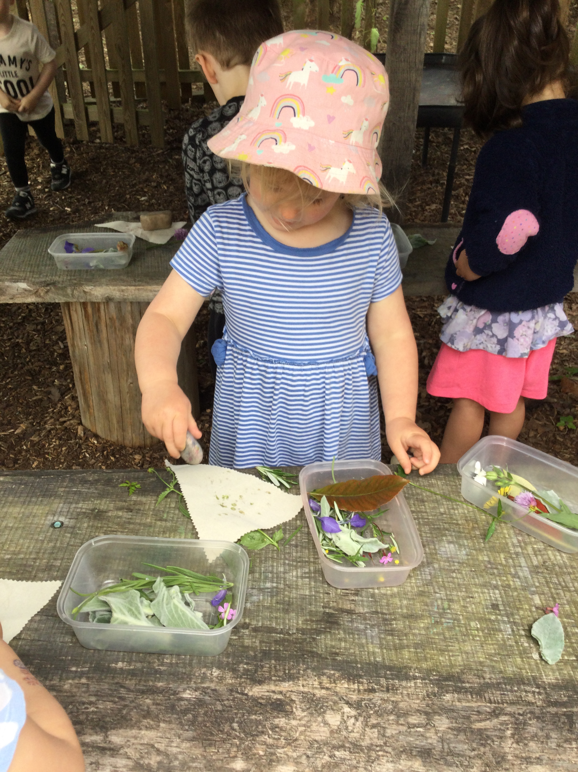
Marketing—a member who liaises with local advertising companies to promote our fundraising events and writes reports of these events for the local community to read about. This committee member will also design the marketing materials to promote these events in the immediate and local villages.
Fundraisers—a valuable team of committee members who support the planning and implementation of the head fundraiser.
The committee is always looking for extra help at our fundraising events to either man a stall or bake a cake, or even help set up. There is a board in the Playhouse corridor with information about our committee members, if you’d like to be a part of our team please get in touch!
We feel it is important as a committee to engage the wider community of Helpston and local families in events that we organise.
As a group we often promote social events with parents and carers to engage in open discussions, questions and answers about the running and development of the Pre-School setting, and we endeavour to provide support for all families involved in the setting.
We have hosted ’Coffee mornings’, ’Evening Socials’ (at the pub!) where everyone is invited and we have useful and informing conversations about the care and provisions for our children, on topics including Tapestry, Jolly Phonics and upcoming fundraising events. And of course, it’s vital for parents and carers to socialise and support each other with our children’s development and happiness in our community.
If you think you would also like to join
the committee, please speak to one of
the staff in the setting and they will
arrange for the Chair to get in contact.
Or you are welcome to contact our
Chair at:
playhouse@helpstonplayhouse.com

Slide 18
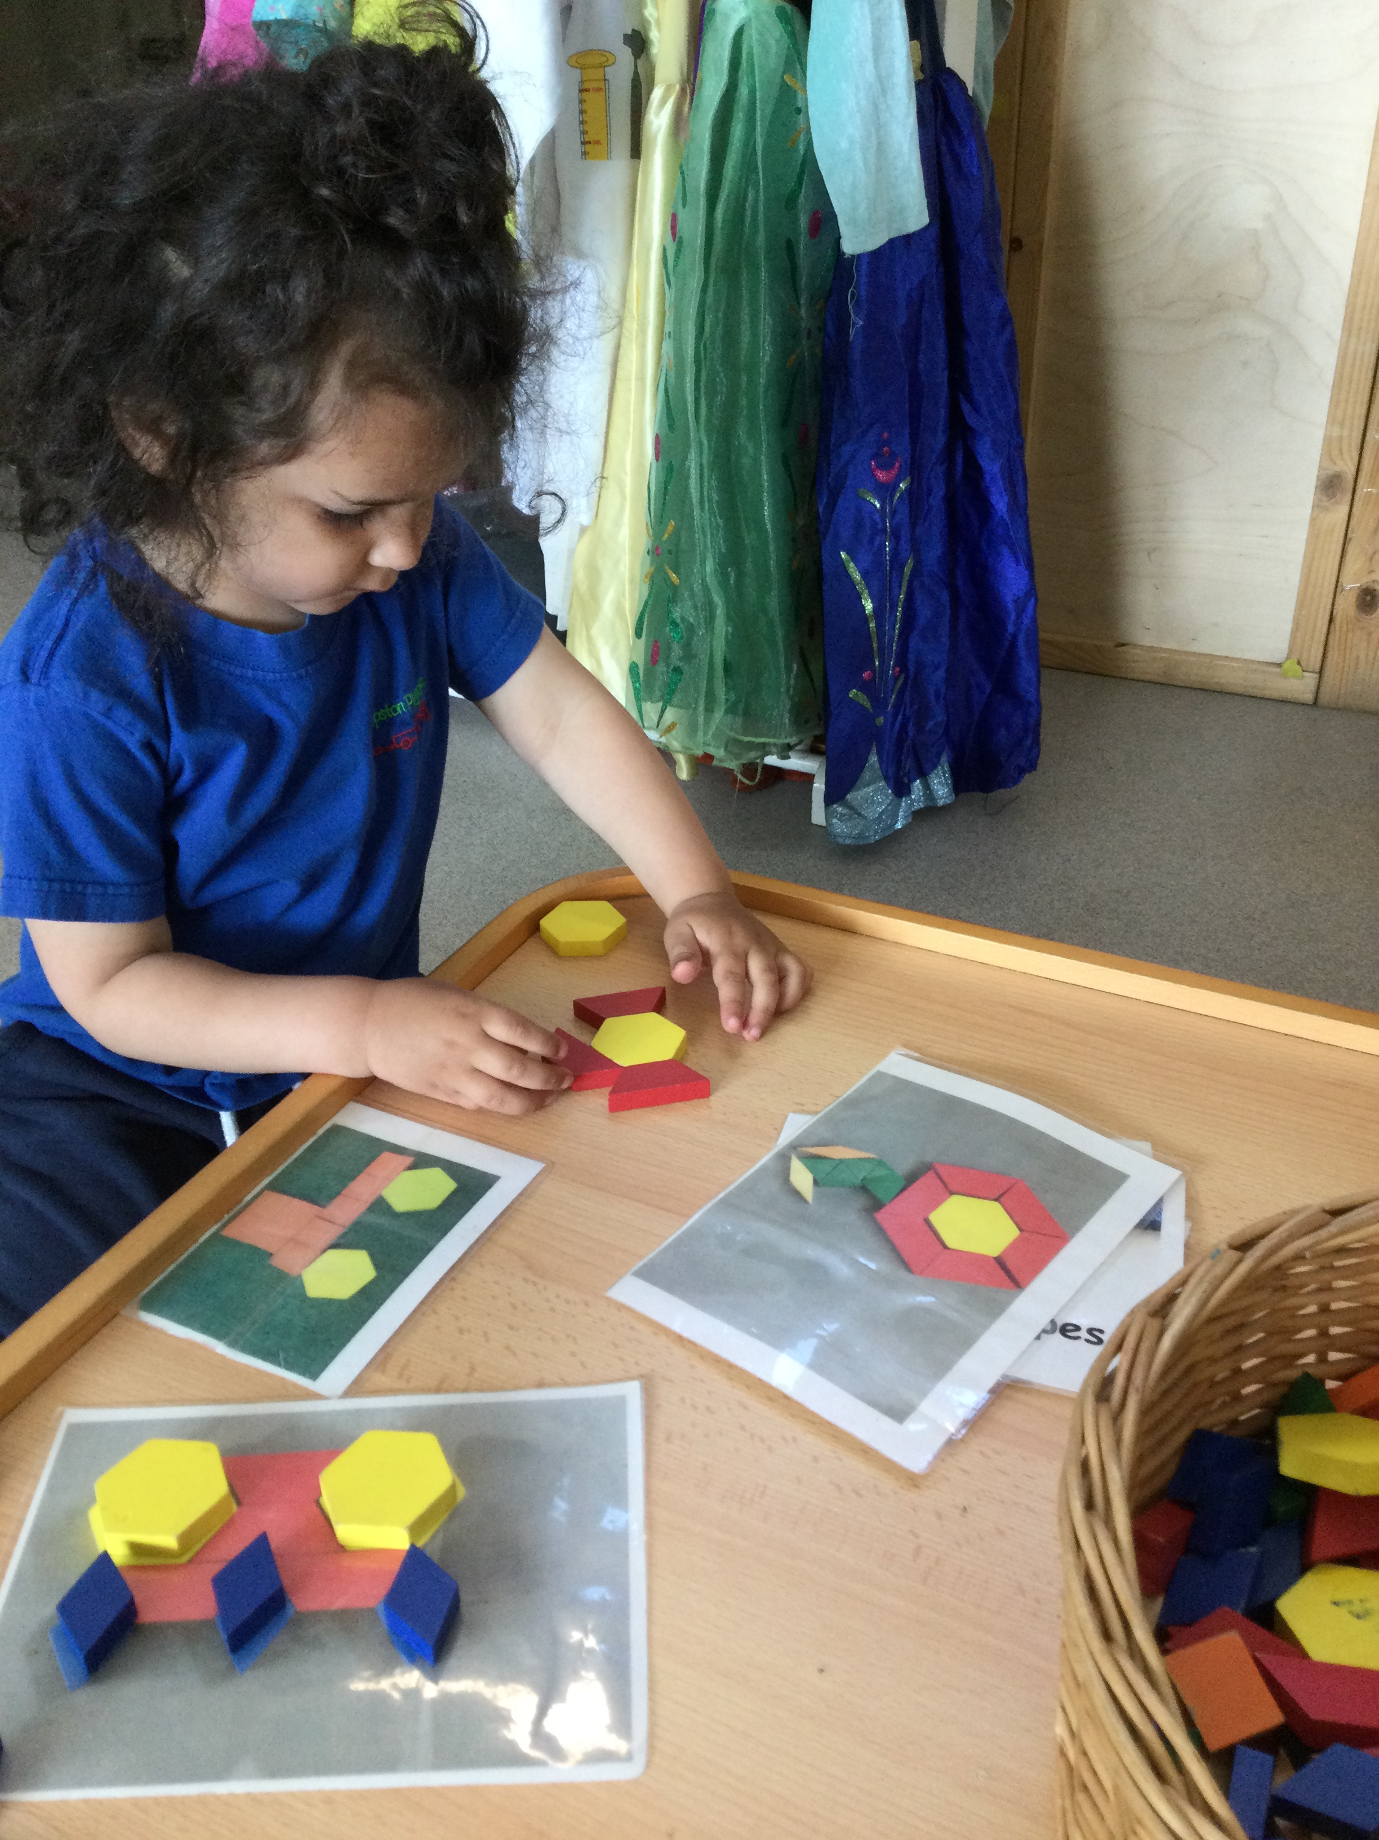
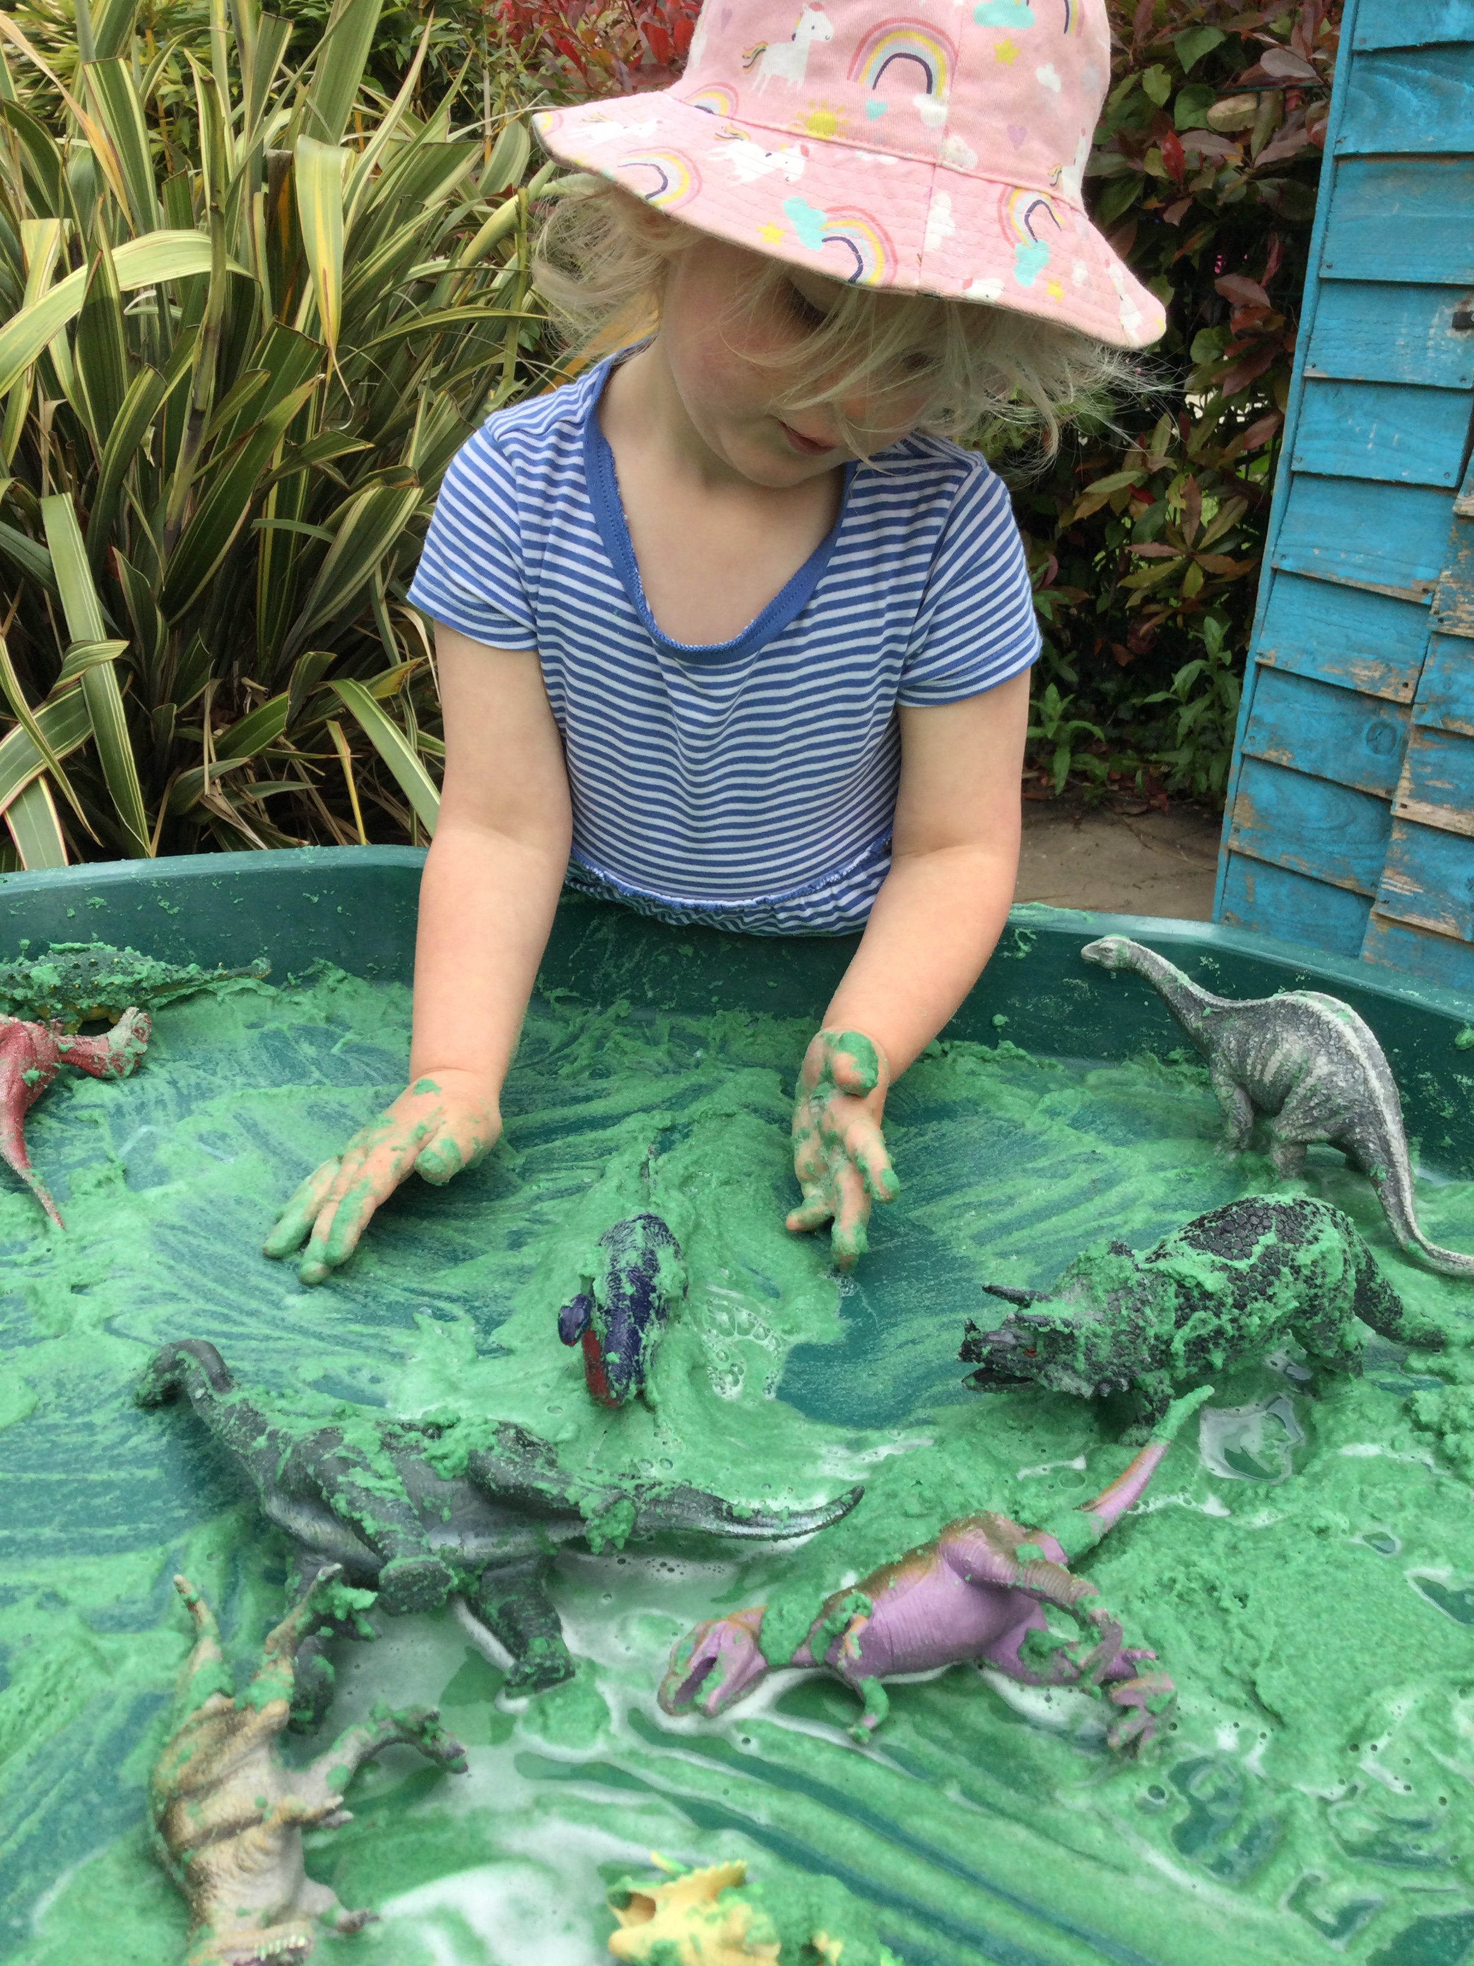
Parent & Toddler Sessions Why not come and join us for our free Parent & Toddler Sessions From Age 12 months to 4 years Fridays 10.00am – 11.30am Stay & Play & join in the preschool fun with fun, games & crafts Parents / Grandparents are responsible for your child Healthy Snack for Children Tea & Coffee
Follow us on Facebook for Playhouse community events! @HelpstonPlayhouse
We hope you find this booklet useful!
Please do not hesitate to contact us if you have any questions - we are here to help.
playhouse@helpstonplayhouse.com
01733 253243

